Slide 1

Matt. 16:13-18
Now when Jesus came into the district of Caesarea Philippi, he asked his disciples, “Who do people say that the Son of Man is?” And they said, “Some say John the Baptist, others say Elijah, and others Jeremiah or one of the prophets.” He said to them, “But who do you say that I am?” Simon Peter replied, “You are the Christ, the Son of the living God.” And Jesus answered him, “Blessed are you, Simon Bar-Jonah! For flesh and blood has not revealed this to you, but my Father who is in heaven. And I tell you, you are Peter, and on this rock I will build my church, and the gates of hell shall not prevail against it.

Slide 3

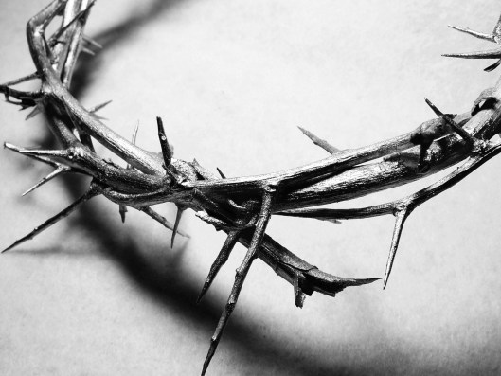
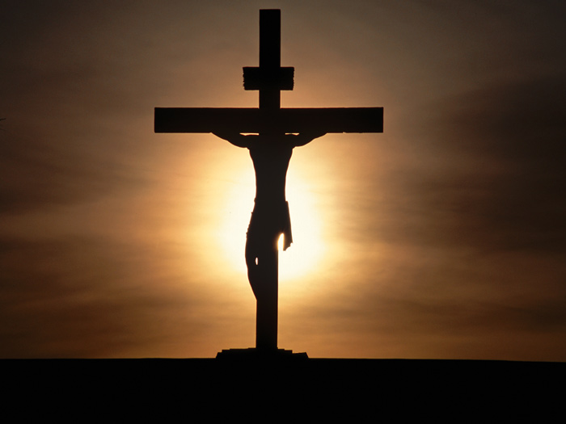
You declare the Lord’s death until He comes

Slide 4
What then? Are we Jews any better off? No, not at all. For we have already charged that all, both Jews and Greeks, are under sin, as it is written: “None is righteous, no, not one; no one understands; no one seeks for God. All have turned aside; together they have become worthless; no one does good, not even one.” …But now the righteousness of God has been manifested apart from the law, although the Law and the Prophets bear witness to it— the righteousness of God through faith in Jesus Christ for all who believe. For there is no distinction: for all have sinned and fall short of the glory of God, and are justified by his grace as a gift, through the redemption that is in Christ Jesus, whom God put forward as a propitiation by his blood, to be received by faith. This was to show God's righteousness, because in his divine forbearance he had passed over former sins. It was to show his righteousness at the present time, so that he might be just and the justifier of the one who has faith in Jesus… “Blessed are those whose lawless deeds are forgiven, and whose sins are covered; blessed is the man against whom the Lord will not count his sin.”

Slide 5
Therefore, since we have been justified by faith, we have peace with God through our Lord Jesus Christ. Through him we have also obtained access by faith into this grace in which we stand, and we rejoice in hope of the glory of God… For while we were still weak, at the right time Christ died for the ungodly. For one will scarcely die for a righteous person—though perhaps for a good person one would dare even to die— but God shows his love for us in that while we were still sinners, Christ died for us. Since, therefore, we have now been justified by his blood, much more shall we be saved by him from the wrath of God. For if while we were enemies we were reconciled to God by the death of his Son, much more, now that we are reconciled, shall we be saved by his life. More than that, we also rejoice in God through our Lord Jesus Christ, through whom we have now received reconciliation… Now the law came in to increase the trespass, but where sin increased, grace abounded all the more, so that, as sin reigned in death, grace also might reign through righteousness leading to eternal life through Jesus Christ our Lord. (Selections From Romans)

Slide 7
What Is The Church oF Christ?

Slide 8
What Is The Church Of Christ?
Understanding the nature of the church of Christ:
  Two different uses in the New Testament of “church”
    It is used in “secular” ways, but we’re looking at spiritual
    Used universally (Eph 1:22; 3:20-21; 5:23ff) ➔ All the saved of all time of all nations. Body, Bride, Kingdom, etc
    Used locally (Acts 11:22, 26; Rom. 16:16) ➔ Christians in a localized place worshipping and working together. Church at _____, church of Christ, church of God, saints in _____
    While local churches may have accepted and active members who are unfaithful, the church of Christ in the universal sense does not. Only saved people are there
    Can we speak of “going to church” (I Cor 14:19, 28, 34)?

Slide 9
What Is The Church Of Christ?
Understanding the nature of the church of Christ:
  The church of Christ (universal sense) is not a collection of certain churches, but is a collection of saved people!
    What about teaching of vine and branches? Wouldn’t each religious group or church be a branch? (John 15:5)
    Jesus doesn’t say that at all! “YOU are the branches” – He is speaking to individuals, not to churches or sects
    Be careful about thinking of the church of Christ as a collection of churches you esteem as faithful!
    This church has no council or gathering. It has no head on Earth, it’s only head is Christ. There is no way for it to engage in a collective activity. It doesn’t teach or practice

Slide 10
What Is The Church Of Christ?
Understanding the nature of the church of Christ:
  Jesus made a great promise about the church He would build and the foundation it would have (Matt. 16:16-18)
    A powerful confession – An expression of belief in Jesus’ identity and position and trust in Him
    A powerful provision – Jesus would build His church upon this foundation of faith. Those who would be part of it would have the same kind of faith and confess it!
    A powerful people – Gates of Hades will not prevail against this people! This doesn’t show God’s people on the defense, but on the attack! (1 Corinthians 15:51-54)
    A powerful unity – This would be “MY” church. One church. One people. One way. One Savior! (Eph. 4:4-6)

Slide 11
What Is The Church Of Christ?
Understanding the nature of the church of Christ:
  The writer of Hebrews paints a glorious picture of this body as it exists in two realms (Hebrews 12:22-24)
    See how he says, “The assembly of the firstborn” – Church!
    This group transcends time and space. People in Heaven and on Earth. Saints of all dispensations. On this mountain you find angels, the blood, & Jesus!
    To be a part of this body is to be a part of something much greater than this life or this world. It’s eternal. It’s something that’s unconquerable. Security, hope, strength

Slide 12
What Is The Church Of Christ?
Applying A More Biblical Understanding Of This Church:
  We need to be careful to be accurate, clear, & thoughtful in our words to others (I Cor. 14:23)
    “Insider Language” is a real thing – Not everyone understands. Not everyone uses the same terms the same way.
    When we talk collectively about this church are we really thinking about a bunch of local churches? Do we use it in a sectarian way to describe what kind of Christian we are? Is this church drifting? What does this church believe and practice? Was this church restored during the 1800’s?
    Sometimes when attempting to address the problem of denominationalism we leave a sectarian impression about it
    “Church of Christ” magazines, schools, materials, bookstores?

Slide 13
What Is The Church Of Christ?
Applying A More Biblical Understanding Of This Church:
  Having this understanding and explaining it to others helps when trying to teach others (Acts 2:38, 41, 47)
    The question, “Will only members of the church of Christ be saved?” is often an escape mechanism, intentionally emotional, Biblically dishonest, and incredibly unfair. But it gets asked!
    If you understand what this church is, then you are basically asking, “Will only saved people be saved?” Are local churches where salvation is found? No! It’s in the body of Christ!
    Day of Pentecost – Gospel preached. People believe and seek salvation. Told to repent and be baptized to be saved. They do that. Then God added the saved to the number every day!
    We aren’t trying to convert people to our church, but to Christ. Many efforts to teach go awry due to misplaced focus!

Slide 14
What Is The Church Of Christ?
Applying A More Biblical Understanding Of This Church:
  We should have a much greater appreciation of the body of which we are a members (Rev 21:9ff; Heb 12:25, 28-29)
    Grace! It is an immeasurable blessing and privilege to be a part of this body. We don’t deserve it. --- Rags To Riches ---
    Jesus shows John in Revelation the beauty, worth, and importance He places upon His people.
    Hebrews “so what” – Obey His voice with reverence! Have a thankfulness that is manifest in your worship. Don’t give it up!
    If we envision this church as a collection of local churches, we won’t have the awe we should be possessed with! When the glory in our hearts fades, so will our faithfulness!

Slide 15
What Is The Church Of Christ?
Applying A More Biblical Understanding Of This Church:
  How does a person join this great body?
    Not through a local church, religious group, or decision of man. This is Christ’s church, His body, and only He can add you!
    If this is simply a group of all of the saved, then we simply have to determine how or when a person becomes saved!
    Again, Acts 2 – Prophets spoke that it’d be a day of salvation. Jesus is preached. They believe. They were told to repent & be baptized for forgiveness of sins. They were then implored to be saved. Then they were baptized. Then said to be saved.
    Compare: Eph. 2:4-10; Gal. 3:26-27; Rom 6:3-4; 1 Cor. 12:13
    By doing this, a person isn’t joining a specific local church. God adds them to His church. A saved person may choose to join a local church, but that’s secondary to being in this body!

