Slide 1

THESSALONICA
In Pursuit Of Excellence

Slide 2

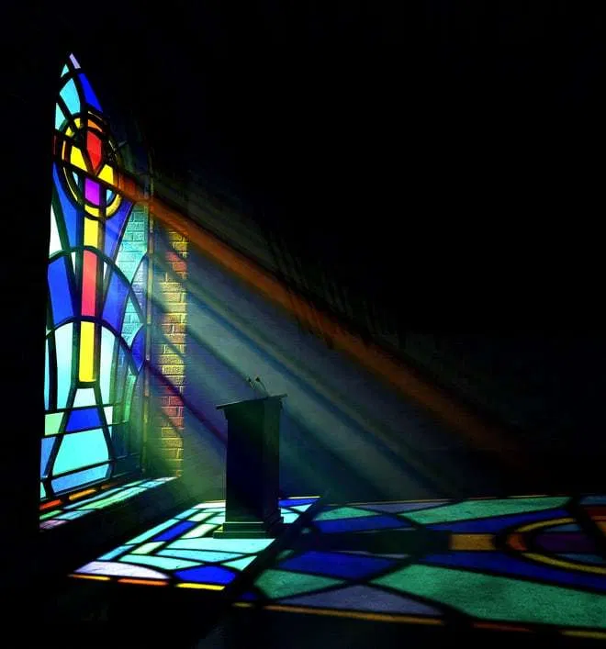
Their Past Did Not Confine Them
Paul’s first interaction – A mixed bag of results. Some obeyed, some rejected. Some were joyful, some were angry. Suffering came. (Acts 17:4-10)
Initially, they were the example of how NOT to respond to gospel preaching! They were not noble. They didn’t search the scriptures. (vs. 10-11)
But something changed… Later, Paul spoke of the Thessalonians with great thankfulness and praise. They were setting the standard! (1 Thess 1:1-3, 7-8)
One of the biggest obstacles to excellence in both Christians & local churches is the past… Sometimes our past is so great it becomes the source of our confidence and we take our state for granted. Sometimes our past is so troubled that we feel to guilty, ashamed, and worthless to excel. We must learned to forget and press on! (Phil 3:12-16)

Slide 3
Their Faith, Hope, And Love Was Alive
Their work of faith. Faith without works is dead (James 2:20, 26). Not completed, but active and growing (2 Thess 1:3). Not just doing plus believing, faith motivated everything they did
Their labor of love. As in a marriage, it is a conscious choice. It speaks of zeal & passion in their deeds. Had not left first love (Rev. 2:4)
Their patience of hope. Work… Labor… How does patience fit (Rev. 2:19; Jas 1:4)? Hope was their foundation, their anchor, and their driving force in life. It wasn’t better felt than told… it was seen, it was heard, it was inspiring. Gave them protection as a helmet against Satan (1 Thess. 5:8)
Can others see your faith, hope, and love on a daily basis? If we aren’t being driven by these, our religion is empty. If we don’t focus on these each day, what do you have when life hits? (1 Cor. 13:13)

Slide 4
The Responded To The Gospel In Obedience
Powerful preaching met by a powerful response. They became imitators. (1 Thess 1:5-6; 1 Cor. 11:1)
These Christians responded by faith despite having to do it in the midst of much affliction. Easy to delay, make excuses, blame God. (2 Cor. 8:1-2, 5)
Faith, hope, & love as they obeyed (1 Thess 1:9-10)
  Work of Faith – Turned away from idols to God
  Labor of Hope – Turned from idols to serve God
  Patience of Love – Focused on eternity. WAIT!
Have you responded to the gospel of Christ? Why not? If you have, do you continue to respond by faith, hope, and love each day? Obeying the gospel is not a ONE TIME event. (2 Cor. 10:3-6)

Slide 5
The Gospel Sounded Forth From Them
At one time, this city was in great need of the gospel. So many in their city had never even heard. So many were lost and didn’t know it! (Acts 17:6)
Now, the saints in this city were the ones sending the gospel to other places. Physical hardship and spiritual affliction did not hamper them (1 Ths 1:8)
What motivated this zeal? A sense of debt? A sense of gratitude? A love for souls? A desire to please God? Passion in the message? (Rom 1:14-16)
All churches that excel share this characteristic… they have members who are telling others about Jesus & His gospel. Motivated & passionate. How many around you are lost and don’t know it? You have the answer! (Romans 15:17-21)

