Slide 1
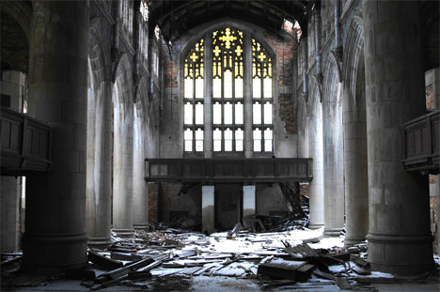

Slide 2
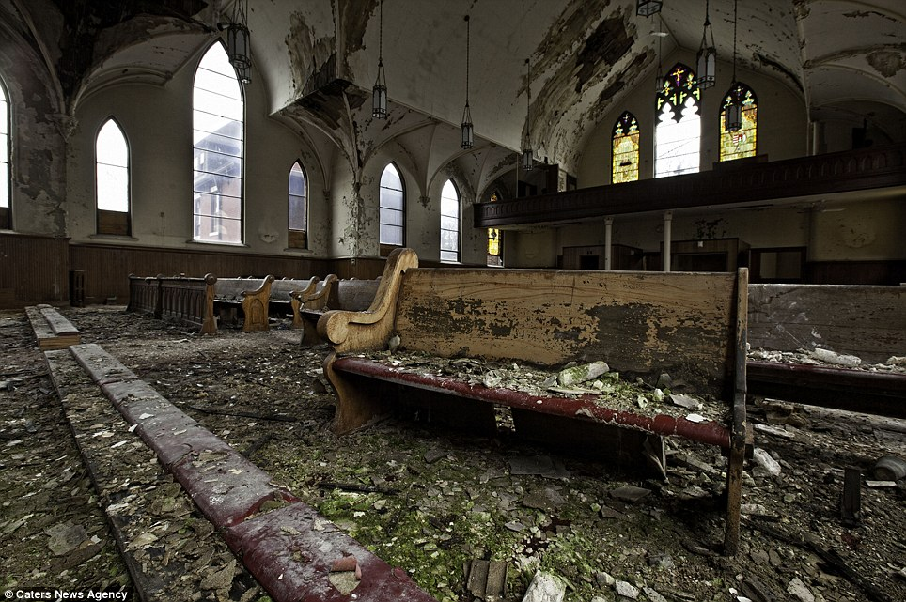

Slide 3
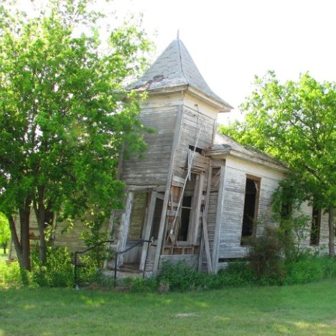

Slide 4
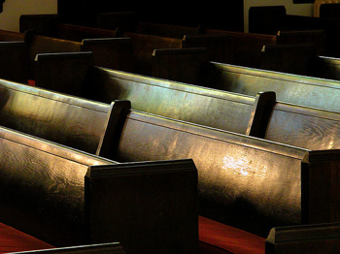
Powerful And Meaningful Religion

Slide 5
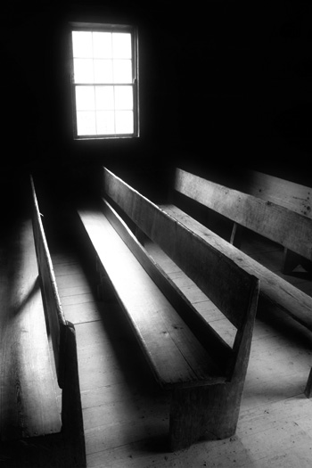
Powerful And Meaningful Religion
By faith working through love:
  Neither circumcision nor uncircumcision makes the difference, but faith that works through love (Galatians 5:6)
    Background: Some sought to bind circumcision on all Christians, as if it made the difference. There are several very bad consequences to doing this (verses 1-4)
    Such religion is certainly vain. It does nothing in a person and it does nothing through a person – “Have strength, power, avail, force”
    Circumcision has no impact on this… What does is possessing a faith that is active on a daily basis and has love as its motivating force
  Danger 1: It is possible to be full of faith and love, but if it is not working it is meaningless in our lives (James 2:17-19, 22, 24)

Slide 6
Powerful And Meaningful Religion
By faith working through love:
  Danger 2: Being full of love and works, but not having faith in it (Romans 9:30-32)
  Danger 3: Our religion focuses on faith and works, but love is not at the core (1 Cor. 13:1-3; 1 John 3:16-18)
  Is our faith doing things for others out of a sincere love for them? Does our faith cause us to become servants? (James 1:26-27)

Slide 7
Powerful And Meaningful Religion
By keeping God’s commandments:
  It’s easy to focus on the previous point… Just believe in God, do good, and love others
    All that is necessary is for a person to be saved is to be passionate and active. Convenient… All religious are saved!
    The authority of God’s word is ignored. Does it matter what we do, what we believe, and how we do things? “Everyone is going to the same place, we are all just taking different paths”
    But sincerity alone is not enough, love alone is not enough, and action alone is not enough. Even all three together is not enough. We must be within God’s will for our religion to have power & meaning

Slide 8
Powerful And Meaningful Religion
By keeping God’s commandments:
  Neither circumcision nor uncircumcision counts for anything, but keeping God’s commandments (1 Cor. 7:17-20)
    Context: Answering particular questions. Dealing with difficulties that resulted from their present distress. Point: Don’t get caught up in changing external things in your life, focus on obeying the Lord.
    When all was said and done, all that mattered was that they were obeying God. These things wouldn’t impact their salvation, but obedience would. Shouldn’t let anything distract them
    For us it may not be circumcision, but we get distracted easily. Could be dating, finances, looks, friendships, fame, success, etc.
    More time, energy, priorities, and affections get placed on things that don’t ultimately. We focus less on obeying God (Matthew 16:26)

Slide 9
Powerful And Meaningful Religion
By keeping God’s commandments:
  With this point Jesus drew the SOTM to a close. No amount of religiousness makes up for being outside God’s will (Matt 7:21-23)
  There is also power and meaning in the assurance and confidence we gain through knowing we are obeying God and what He promises in response to that (1 John 2:3-4; 3:24; 5:2-3)

Slide 10
Powerful And Meaningful Religion
By being a new creation:
  More on circumcision… It is not what makes a difference, but a new creation (Gal 6:15)
    Some were boasting in their circumcision instead of focusing their glory on the cross of Christ
    What about the cross? Through it I have been crucified to the world and the world to me. The cross not only saved Paul, but forever changed Paul. Made him new. How he responded mattered
    The cross represents Jesus and His sacrifice for us - Through it, Paul’s relationship with the world completely changed. Forever done.
    Like in Romans… Some who had never been circumcised were seen as circumcised because they lived the life circumcision was meant to produce. Separated, obedient, & dedicated (Romans 2:25-29)

Slide 11
Powerful And Meaningful Religion
By being a new creation:
  A Christian is a creation of God… a person transformed by His power and will. God’s masterpiece! (2 Cor 5:17; Eph. 2:8-10)
    Be done with old! It’s dead. It’s the past. Not what Christ is about.
    All is made new in Christ! Relationships with others, relationships with God, attitude toward this world, focus in life, relationship to sin, position with the devil, our hope… AND MUCH MUCH MORE!
    We are God’s workmanship – We must remember this! I am not my own workmanship, but God’s. It’s not “self improvement” but “God improvement” – Go wherever God leads whenever He leads!
    Too often we try to be the master doing the creating. We set the rules, we decide how far to go with it. If so, we are our own workmanship, not God’s workmanship.

Slide 12
Powerful And Meaningful Religion
By being a new creation:
  What does a new creation look like? The practical side can be difficult (Col. 3:1-4)
    Being raised with Christ changes everything. A changed focus. Jesus is at the center. All revolves around Christ.
    Certain things will be put to death (vs. 5-10)
    Certain things will be put on (vs. 12-17)
    This change will permeate every aspect of my life – Whether at home, at work, or whatever I do, I am a new creation (vs. 18-25)
    We all probably need to do some dying. We all need to do some putting on. Purposefully choose to make Christ all in all in our life.
  When does a person become a new creation? There is a fixed point in time when this happens. Baptism marks that moment where we’re raised to walk in new life (Rom 6:1-4, 11-13)

Slide 13
Powerful And Meaningful Religion
By being a new creation:
  But being a new creation is also an ongoing process. For our religion to have meaning and power we cannot stop being made new. We are always being “renewed” (Rom 12:1-2; 2 Cor. 4:16-18)

