Slide 1

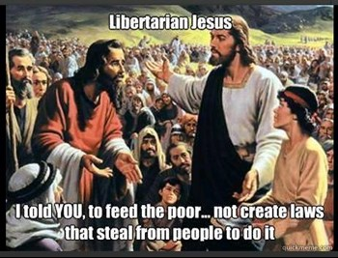

Slide 2
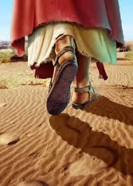
And he said to them, “Let us go on to the next towns, that I may preach there also, for that is why I came out.” And he went throughout all Galilee, preaching in their synagogues and casting out demons (Mk 1:38-39)
And when Jesus heard it, he said to them, “Those who are well have no need of a physician, but those who are sick. I came not to call the righteous, but sinners.” (Mark 2:17)
We must work the works of him who sent me while it is day; night is coming, when no one can work. As long as I am in the world, I am the light of the world (Jn 9:4-5)
The thief comes only to steal and kill and destroy. I came that they may have life and have it abundantly (John 10:10)

Slide 3

The Scariest Page In The Bible

Slide 4

Choose Between Wide And Narrow Way (Matthew 7:13-14)
I call heaven and earth to witness against you today, that I have set before you life and death, blessing and curse. Therefore choose life, that you and your offspring may live, loving the LORD your God, obeying his voice and holding fast to him, for he is your life and length of days, that you may dwell in the land that the LORD swore to your fathers, to Abraham, to Isaac, and to Jacob, to give them.”
(Deuteronomy 30:19-20)

Slide 5
Choose Between Wide And Narrow Way (Matthew 7:13-14)
Jesus said to him, “I am the way, and the truth, and the life. No one comes to the Father except through me.
(John 14:6)

Slide 6
Choose Between Wide And Narrow Way (Matthew 7:13-14)
For the time that is past suffices for doing what the Gentiles want to do, living in sensuality, passions, drunkenness, orgies, drinking parties, and lawless idolatry. With respect to this they are surprised when you do not join them in the same flood of debauchery, and they malign you
(I Peter 4:3-4)

Slide 7
There Is A Danger Of False Prophets (Matthew 7:15-20)
I appeal to you, brothers, to watch out for those who cause divisions and create obstacles contrary to the doctrine that you have been taught; avoid them. For such persons do not serve our Lord Christ, but their own appetites, and by smooth talk and flattery they deceive the hearts of the naive. (Rom 16:17-18)

Slide 8
There Is A Danger Of False Prophets (Matthew 7:15-20)
I am astonished that you are so quickly deserting him who called you in the grace of Christ and are turning to a different gospel — not that there is another one, but there are some who trouble you and want to distort the gospel of Christ. But even if we or an angel from heaven should preach to you a gospel contrary to the one we preached to you, let him be accursed. As we have said before, so now I say again: If anyone is preaching to you a gospel contrary to the one you received, let him be accursed. (Galatians 1:6-9)

Slide 9
Some Will Have Deceived Themselves (Matthew 7:21-23)
Everyone who goes on ahead and does not abide in the teaching of Christ, does not have God. Whoever abides in the teaching has both the Father and the Son. If anyone comes to you and does not bring this teaching, do not receive him into your house or give him any greeting, for whoever greets him takes part in his wicked works.
(2 John 9-11)

Slide 10
The Practicality Of Respecting This Reality
Build on the rock… Hear and obey Jesus (vs. 24-27)
Be motivated to talk to others about Jesus and the gospel (Mark 6:34-35a)
Be devoted to studying and knowing God’s word even more (Romans 10:1-3)
Pursue the authority of God in your personal walk and in the life of the local church (2 Tim 2:14-15; 3:16-17)
Stand for the truth, but do it with humility, grace, and mercy (Acts 18:24-28, 19:1ff)

