Slide 1
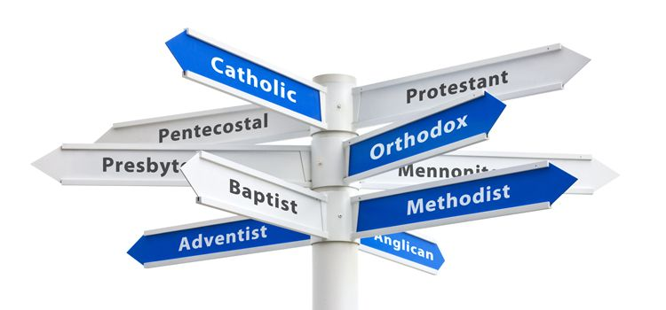

Slide 2
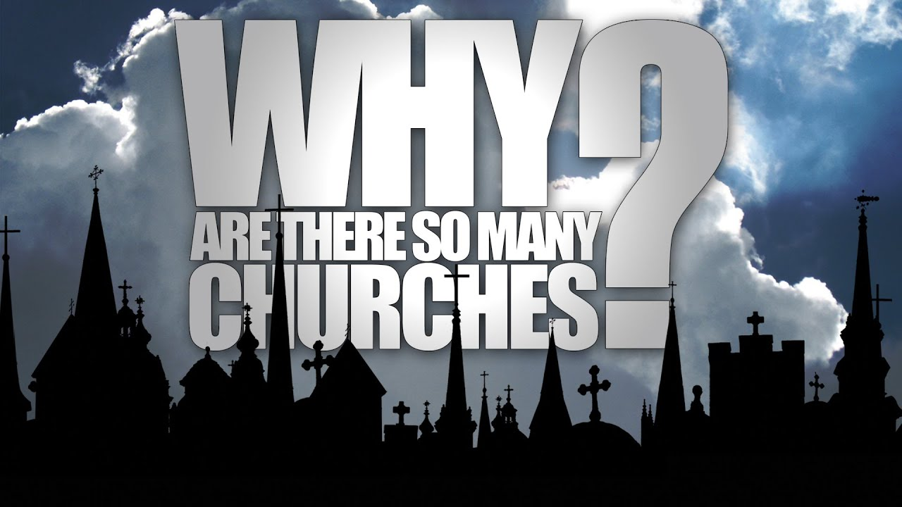

Slide 3

Simply
Christians

Slide 4
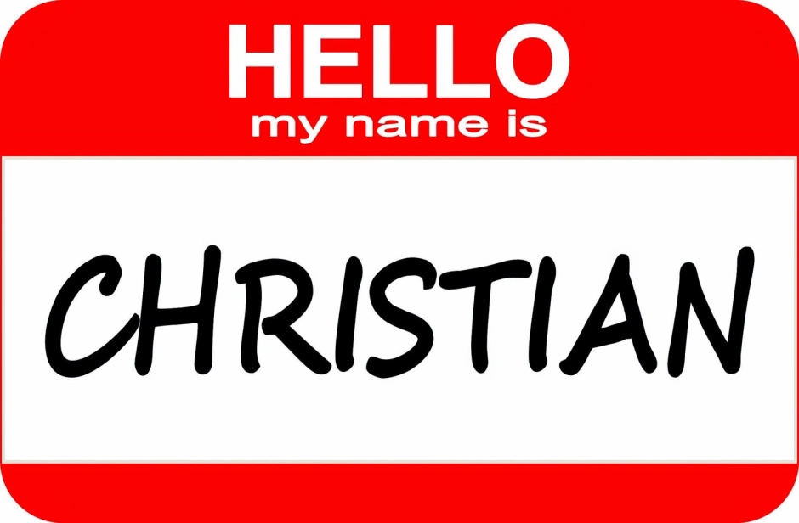
What’s In A Name?
Isaiah prophesied of a new name (Isaiah 56:4-5; 62:2-4; 65:13-16)

Slide 5
For thus says the LORD: “To the eunuchs who keep my Sabbaths, who choose the things that please me and hold fast my covenant, I will give in my house and within my walls a monument and a name better than sons and daughters; I will give them an everlasting name that shall not be cut off. (Isaiah 56:4-5)
The nations shall see your righteousness, and all the kings your glory, and you shall be called by a new name that the mouth of the LORD will give. You shall be a crown of beauty in the hand of the LORD, and a royal diadem in the hand of your God. You shall no more be termed Forsaken, and your land shall no more be termed Desolate, but you shall be called My Delight Is in Her, and your land Married; for the LORD delights in you, and your land shall be married. (Isaiah 62:2-4)
behold, my servants shall sing for gladness of heart, but you shall cry out for pain of heart and shall wail for breaking of spirit. You shall leave your name to my chosen for a curse, and the Lord GOD will put you to death, but his servants he will call by another name, so that he who blesses himself in the land shall bless himself by the God of truth, and he who takes an oath in the land shall swear by the God of truth; because the former troubles are forgotten and are hidden from my eyes. (Isaiah 65:14-16)

Slide 6
What’s In A Name?
Isaiah prophesied of a new name (Isaiah 56:4-5; 62:2-4; 65:13-16)
These prophecies are seen fulfilled in the early church in the book of Acts (1:8; 2:41; 8:4; 10:47-48; 11:18, 21, 26)

Slide 7
But you will receive power when the Holy Spirit has come upon you, and you will be my witnesses in Jerusalem and in all Judea and Samaria, and to the end of the earth.” (Acts 1:8)
So those who received his word were baptized, and there were added that day about three thousand souls. (Acts 2:41)
Now those who were scattered went about preaching the word. (Acts 8:4)

Slide 8
“Can anyone withhold water for baptizing these people, who have received the Holy Spirit just as we have?” And he commanded them to be baptized in the name of Jesus Christ. Then they asked him to remain for some days. (Acts 10:47-48)
When they heard these things they fell silent. And they glorified God, saying, “Then to the Gentiles also God has granted repentance that leads to life.” (Acts 11:18)
And the hand of the Lord was with them, and a great number who believed turned to the Lord… and when he had found him, he brought him to Antioch. For a whole year they met with the church and taught a great many people. And in Antioch the disciples were first called Christians. (Acts 11:21, 26)

Slide 9
What’s In A Name?
Isaiah prophesied of a new name (Isaiah 56:4-5; 62:2-4; 65:13-16)
These prophecies are seen fulfilled in the early church in the book of Acts (1:8; 2:41; 8:4; 10:47-48; 11:18, 21, 26)
If other descriptions exist, why is the name Christian so prolific among believers today? It is HIS name. It is the fulfillment of prophecy (Deut. 28:9-10)

Slide 10
The LORD will establish you as a people holy to himself, as he has sworn to you, if you keep the commandments of the LORD your God and walk in his ways. And all the peoples of the earth shall see that you are called by the name of the LORD, and they shall be afraid of you. (Deuteronomy 28:9-10)

Slide 11
What’s In A Name?
Isaiah prophesied of a new name (Isaiah 56:4-5; 62:2-4; 65:13-16)
These prophecies are seen fulfilled in the early church in the book of Acts (1:8; 2:41; 8:4; 10:47-48; 11:18, 21, 26)
If other descriptions exist, why is the name Christian so prolific among believers today? It is HIS name. It is the fulfillment of prophecy (Deut. 28:9-10)
In the NT there are not different types of Christians, but simply Christians. They wore one name! (2 Tim 2:19; Rev. 14:1)

Slide 12
But God's firm foundation stands, bearing this seal: “The Lord knows those who are his,” and, “Let everyone who names the name of the Lord depart from iniquity.” (2 Tim. 2:19)
Then I looked, and behold, on Mount Zion stood the Lamb, and with him 144,000 who had his name and his Father's name written on their foreheads. (Revelation 14:1)

Slide 13
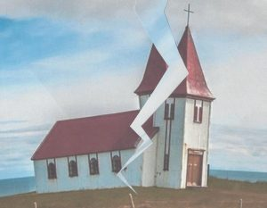
What I mean is that each one of you says, “I follow Paul,” or “I follow Apollos,” or “I follow Cephas,” or “I follow Christ.” Is Christ divided? Was Paul crucified for you? Or were you baptized in the name of Paul?
(1 Corinthians 1:12-13)

Slide 14
A Practical Approach
The Biblical silence about the differences and among Christians we see today is deafening (Acts 2:41, 47; 8:1)

Slide 15
So those who received his word were baptized, and there were added that day about three thousand souls. (Acts 2:41)
praising God and having favor with all the people. And the Lord added to their number day by day those who were being saved. (Acts 2:47)
And Saul approved of his execution. And there arose on that day a great persecution against the church in Jerusalem, and they were all scattered throughout the regions of Judea and Samaria, except the apostles. (Acts 8:1)

Slide 16
A Practical Approach
The Biblical silence about the differences and among Christians we see today is deafening (Acts 2:41, 47; 8:1)
How possible? Unity of teaching and a united devotion to truth…
  1 Corinthians 1:12 – Total unity is standard

Slide 17

I appeal to you, brothers, by the name of our Lord Jesus Christ, that all of you agree, and that there be no divisions among you, but that you be united in the same mind and the same judgment.
(I Corinthians 1:12)

Slide 18
A Practical Approach
The Biblical silence about the differences and among Christians we see today is deafening (Acts 2:41, 47; 8:1)
How possible? Unity of teaching and a united devotion to truth…
  1 Corinthians 1:12 – Total unity is standard
  1 Corinthians 4:17; 14:33-34; 16:1-2 – The same things taught in every church

Slide 19
That is why I sent you Timothy, my beloved and faithful child in the Lord, to remind you of my ways in Christ, as I teach them everywhere in every church.
(I Corinthians 4:17)

Slide 20
For God is not a God of confusion but of peace. As in all the churches of the saints, the women should keep silent in the churches. For they are not permitted to speak, but should be in submission, as the Law also says.
(1 Cor. 14:33-34)

Slide 21
Now concerning the collection for the saints: as I directed the churches of Galatia, so you also are to do. On the first day of every week, each of you is to put something aside and store it up, as he may prosper, so that there will be no collecting when I come. (1 Cor. 16:1-2)

Slide 22
A Practical Approach
The Biblical silence about the differences and among Christians we see today is deafening (Acts 2:41, 47; 8:1)
How possible? Unity of teaching and a united devotion to truth…
  1 Corinthians 1:12 – Total unity is standard
  1 Corinthians 4:17; 14:33-34; 16:1-2 – The same things taught in every church
  Galatians 1:6-9 – Even a distortion to the original gospel must not be tolerated

Slide 23
I am astonished that you are so quickly deserting him who called you in the grace of Christ and are turning to a different gospel — not that there is another one, but there are some who trouble you and want to distort the gospel of Christ. But even if we or an angel from heaven should preach to you a gospel contrary to the one we preached to you, let him be accursed. As we have said before, so now I say again: If anyone is preaching to you a gospel contrary to the one you received, let him be accursed. (Galatians 1:6-9)

Slide 24
A Practical Approach
The Biblical silence about the differences and among Christians we see today is deafening (Acts 2:41, 47; 8:1)
How possible? Unity of teaching and a united devotion to truth…
  1 Corinthians 1:12 – Total unity is standard
  1 Corinthians 4:17; 14:33-34; 16:1-2 – The same things taught in every church
  Galatians 1:6-9 – Even a distortion to the original gospel must not be tolerated
  Acts 17:10-11 – Always examining what was taught and said to make sure it was truth

Slide 25
The brothers immediately sent Paul and Silas away by night to Berea, and when they arrived they went into the Jewish synagogue. Now these Jews were more noble than those in Thessalonica; they received the word with all eagerness, examining the Scriptures daily to see if these things were so.
(Acts 17:10-11)

Slide 26
A Practical Approach
The Biblical silence about the differences and among Christians we see today is deafening (Acts 2:41, 47; 8:1)
How possible? Unity of teaching and a united devotion to truth…
This isn’t just possible, but essential due to authoritative all sufficiency of the scriptures (2 Timothy 3:16-17)

Slide 27
But as for you, continue in what you have learned and have firmly believed, knowing from whom you learned it and how from childhood you have been acquainted with the sacred writings, which are able to make you wise for salvation through faith in Christ Jesus. All Scripture is breathed out by God and profitable for teaching, for reproof, for correction, and for training in righteousness, that the man of God may be complete, equipped for every good work.
(2 Timothy 3:14-17)

Slide 28
A Practical Approach
The Biblical silence about the differences and among Christians we see today is deafening (Acts 2:41, 47; 8:1)
How possible? Unity of teaching and a united devotion to truth…
This isn’t just possible, but essential due to authoritative all sufficiency of the scriptures (2 Timothy 3:16-17)
The religious division that exists today is more than “not good” …it is wrong. It is not a necessary evil… it is just evil. Are we devoted to truth regardless?

Slide 29
Avoiding Sectarian Spirits
Isn’t a church of Christ part of the “Church of Christ” denomination? (Romans 16:16; 2 John 1:9-11)
  Some do have a denominational mindset!
  This church has no real denominational ties
  Similarities between churches does not create a denomination – See 1st c. churches!
  Exclusivity and narrowness does not create a denomination – See 1st c. churches!
We must resist the tendency to view God’s people in a sectarian way. Words often reflect what the way we think.

Slide 30
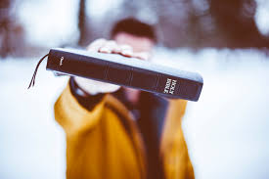
Standing On The Word
test the spirits
practice book, chapter, and verse Christianity
seek scriptural authority for everything
commit to Biblical accuracy
follow the Bible pattern
never stop seeking restoration to New Testament Christianity

