Slide 1


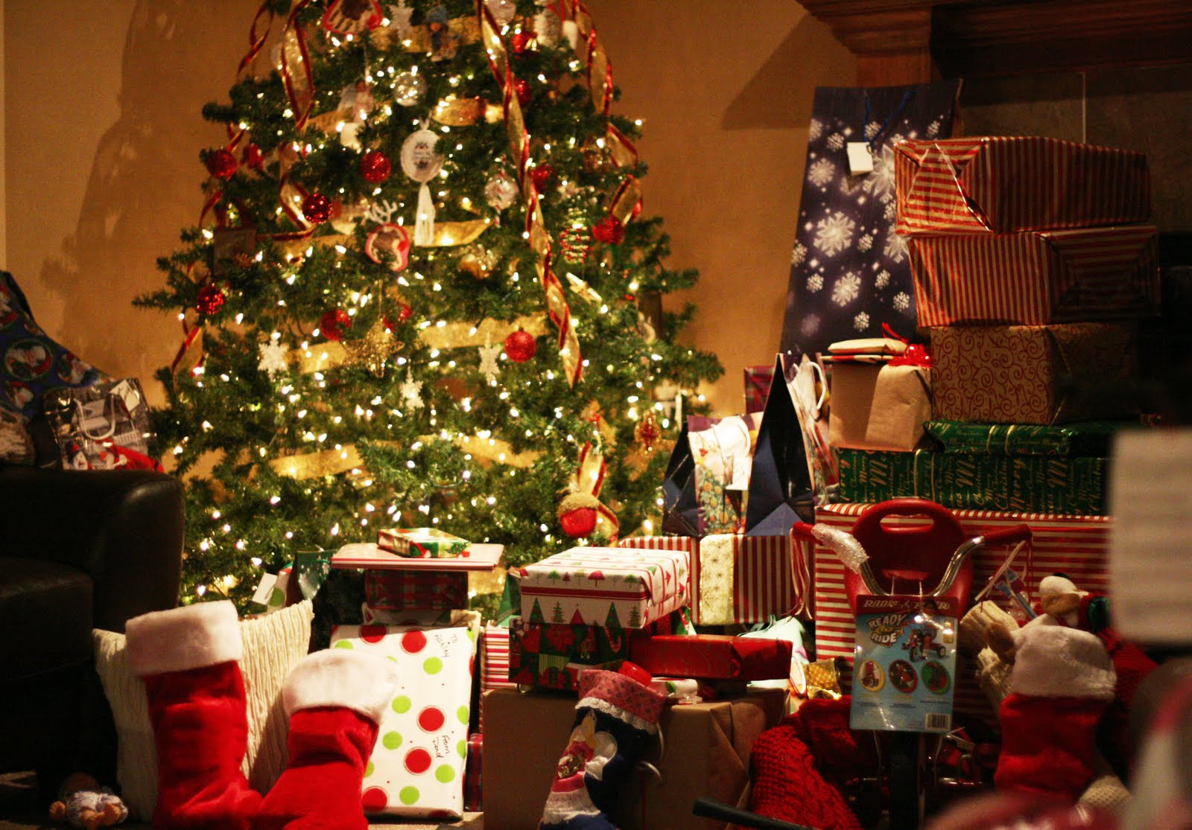
Is it about the presents or the presence?

Slide 2
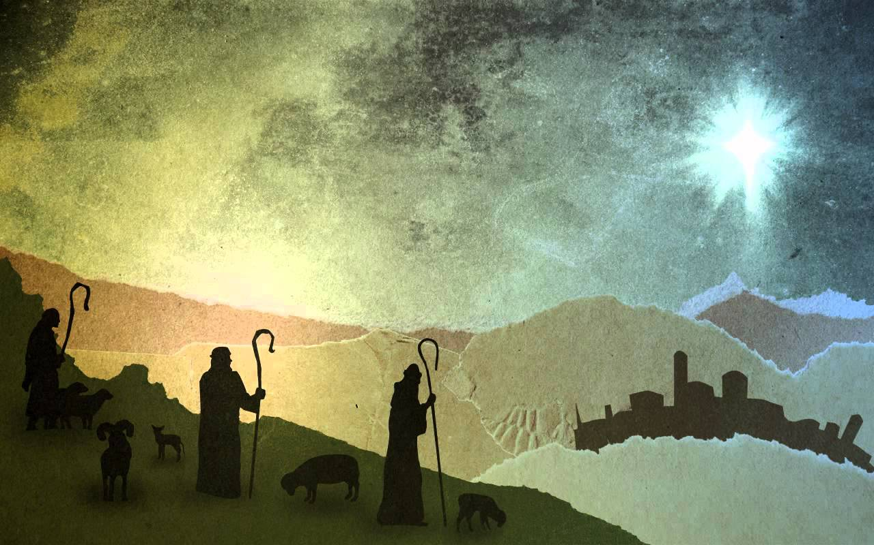
In His Presence

Slide 3

Joseph & Mary
God did not choose the prominent or powerful, but the common. Yet their faith was uncommon! (Luke 2:4-7)
When called, Mary submitted full and freely to God’s will (Luke 1:26-38)
Joseph was sure to do everything just as God had commanded (Matt 1:20-25)
How is our serving & obeying when things are difficult or don’t make sense? Hard stuff proves our love! (I John 5:2-4)

Slide 4
Simeon & Anna
In temple at 40 days old. Devoted to obeying! Here we meet two other people of faith (Lk 2:22-24, Lev 12:1-8)
Simeon… An aged man eagerly waiting for the Messiah (Luke 2:25-33)
Anna… An aged widow eagerly waiting for the Messiah (Luke 2:36-38)
Living with a living hope? Does it change you? Excited about telling others? Or are we distracted? (I Peter 1:3-5, 13)

Slide 5
The Wise Men & The Shepherds
The shepherds were working when the angels appeared, they seek out Jesus with haste (Luke 2:10-18)
About 2 years later, the wise men arrive seek His presence with gifts and reverence. Gentiles! (Matt 2:1-6, 9-12)
Why seek Jesus? He is KING! Do we seek His reign and rule with haste and reverence? (Matthew 28:18-20)

Slide 6
Are You Living In His Presence?

