Slide 1


Slide 2
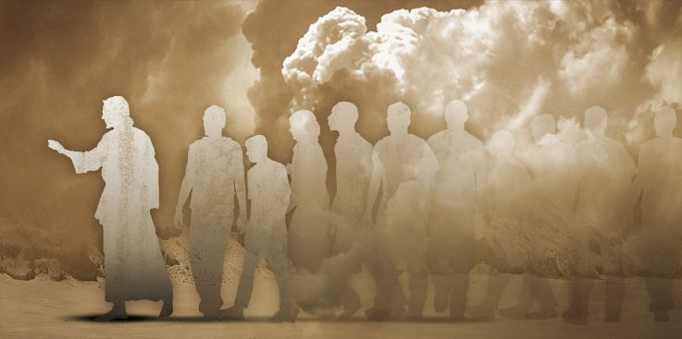
144,000? Faithful disciples who have passed from this life into the presence of the Lord
They have rejected the mark of the beast. Withstood pressure and persecution (Rev. 13:11-18)
These have the name of the Lamb and the Father on their foreheads. Showed loyalty, devotion, belonging. They wore this openly… Allegiance! (14:1)
The sound of rejoicing… God has redeemed His people (vs. 2-3)
They Are Devoted To Fellowship With The Lord

Slide 3
Disciples do not just wear the name of Jesus, they are devoted to Him with bold and unwavering allegiance (2 Tim 2:8-13, 19)
They Are Devoted To Fellowship With The Lord

Slide 4
John uses the imagery of virginity to describe them (14:4a). Likely figurative (Heb 13:4). A symbol of chasteness and purity.
Sexual purity is used of total righteousness (Ezekiel 16:30ff). Both HOLY and WHOLLY His!
Persecution & cultural pressures were real. Had to make great sacrifices (1 Peter 4:1-5)
Disciples are people who take seriously their purity. It is pursued & protected (2 Cor 11:2)
They Are Devoted To Real Purity

Slide 5
They were consistently following Jesus (14:4). Sheep led by a Lamb. The other side of Psalm 23
They could follow the Lamb in eternity because they followed Him wholly in life. Submitted fully to the rule of Christ. Even to death! (Revelation 12:9-10, 17)
Disciples live with a single minded devotion to ONE shepherd (John 10:1-15)
Have anywhere and everywhere mindset? Any black holes in my discipleship? (John 12:23-26)
They Are Devoted To Following The Lamb Always

Slide 6
These people had also taken purity of speech seriously (14:5). False & destructive speech didn’t fit lips devoted to praise & truth
Such consistency of speech only happens when purity is pursued in the heart (Matthew 12:33-37)
Disciples look to match what they confess with how they live (1 John 1:5-7; Jas 3:9-12)
Our words matter. Not just slip of tongues, but exposure of the heart. Pure speech! (Eph. 5:4-5)
They Are Devoted To Complete Honesty

Slide 7
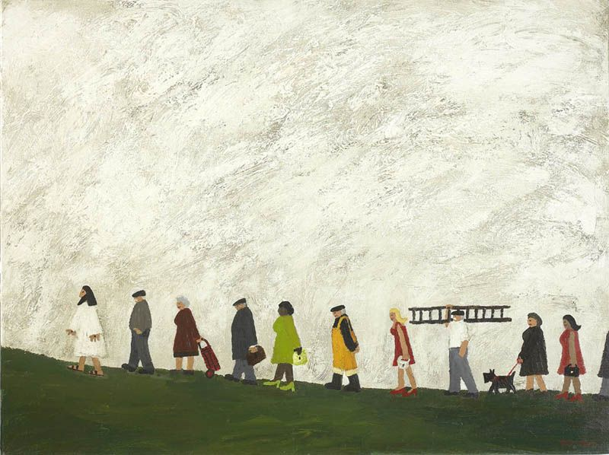
See what kind of love the Father has given to us, that we should be called children of God; and so we are. The reason why the world does not know us is that it did not know him. Beloved, we are God's children now, and what we will be has not yet appeared; but we know that when he appears we shall be like him, because we shall see him as he is. And everyone who thus hopes in him purifies himself as he is pure. (I John 3:1-4)

