Slide 1
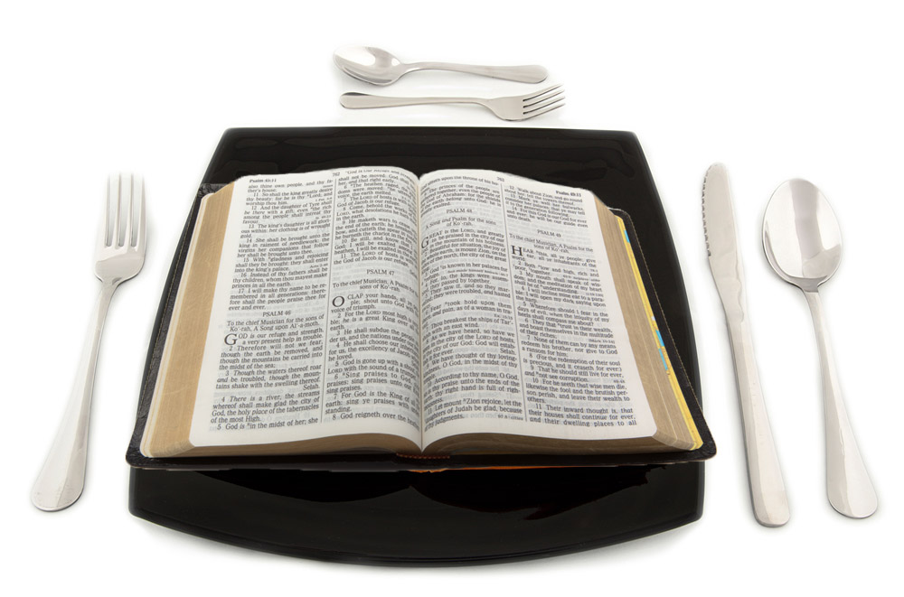

Slide 2
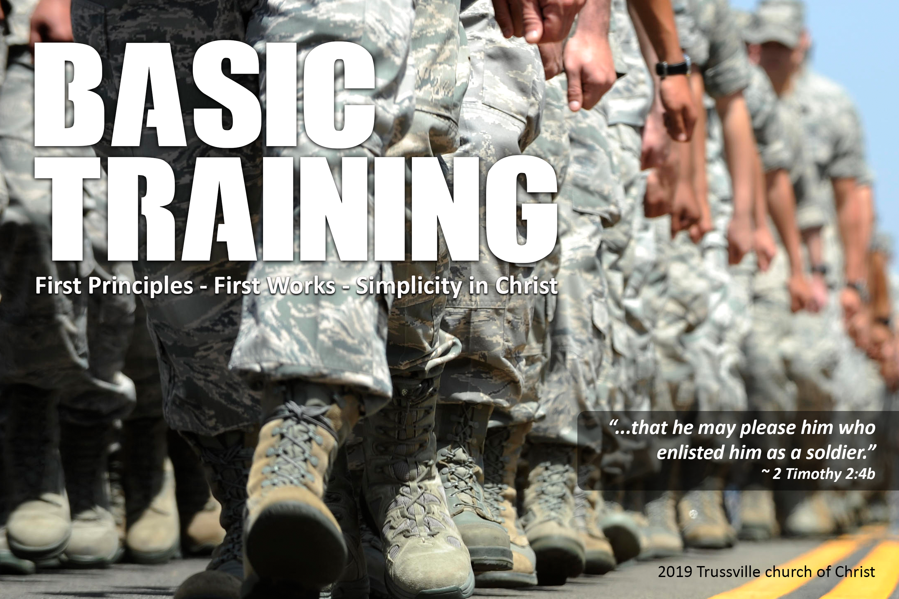

Slide 3
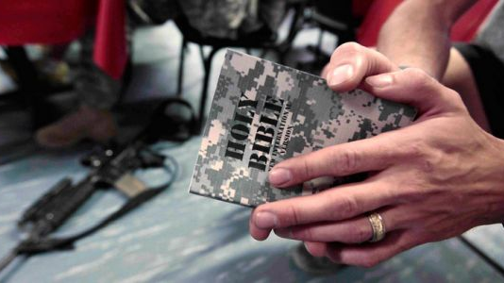
All Scripture is breathed out by God and profitable for teaching, for reproof, for correction, and for training in righteousness, that the man of God may be complete, equipped for every good work.
(2 Timothy 3:16-17)

Slide 4
Seventeen Bible Time Periods
Before The Flood
The Flood
Scattering Of The People
Patriarchs
Exodus
Wandering In The Wilderness
Invasion And Conquest
Judges
United Kingdom
Divided Kingdom
Judah Alone
Captivity
Return From Captivity
Years Of Silence
Life Of Christ
Early Church
Letters To Christians

Slide 5

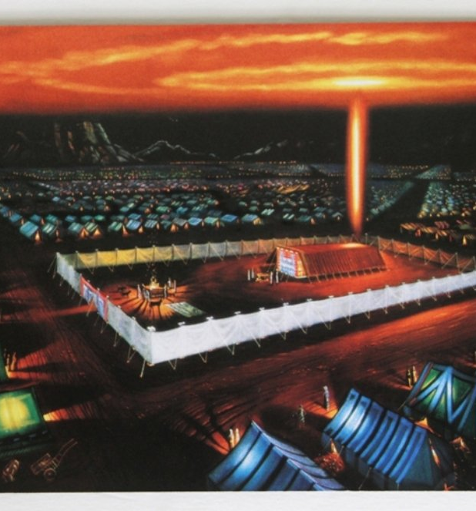
Wandering In The Wilderness
When they came to Marah, they could not drink the water of Marah because it was bitter; therefore it was named Marah. And the people grumbled against Moses, saying, “What shall we drink?” And he cried to the LORD, and the LORD showed him a log, and he threw it into the water, and the water became sweet. (Exodus 15:23-25)

Slide 6
Wandering In The Wilderness
the whole congregation of the people of Israel grumbled against Moses and Aaron in the wilderness, and the people of Israel said to them, “Would that we had died by the hand of the LORD in the land of Egypt, when we sat by the meat pots and ate bread to the full, for you have brought us out into this wilderness to kill this whole assembly with hunger.” Then the LORD said to Moses, “Behold, I am about to rain bread from heaven for you, and the people shall go out and gather a day's portion every day, that I may test them, whether they will walk in my law or not. (Exodus 16:2-4)

Slide 7
Wandering In The Wilderness
On the morning of the third day there were thunders and lightnings and a thick cloud on the mountain and a very loud trumpet blast, so that all the people in the camp trembled. Then Moses brought the people out of the camp to meet God, and they took their stand at the foot of the mountain. Now Mount Sinai was wrapped in smoke because the LORD had descended on it in fire. The smoke of it went up like the smoke of a kiln, and the whole mountain trembled greatly. And as the sound of the trumpet grew louder and louder, Moses spoke, and God answered him in thunder. (Exodus 19:16-19)

Slide 8
Wandering In The Wilderness
Then the cloud covered the tent of meeting, and the glory of the LORD filled the tabernacle. And Moses was not able to enter the tent of meeting because the cloud settled on it, and the glory of the LORD filled the tabernacle. Throughout all their journeys, whenever the cloud was taken up from over the tabernacle, the people of Israel would set out. But if the cloud was not taken up, then they did not set out till the day that it was taken up. For the cloud of the LORD was on the tabernacle by day, and fire was in it by night, in the sight of all the house of Israel throughout all their journeys. (Exodus 40:34-38)

Slide 9
Wandering In The Wilderness
Now the rabble that was among them had a strong craving. And the people of Israel also wept again and said, “Oh that we had meat to eat! We remember the fish we ate in Egypt that cost nothing, the cucumbers, the melons, the leeks, the onions, and the garlic. But now our strength is dried up, and there is nothing at all but this manna to look at.” (Numbers 11:4-6)

Slide 10
Wandering In The Wilderness
and said to all the congregation of the people of Israel, “The land, which we passed through to spy it out, is an exceedingly good land. If the LORD delights in us, he will bring us into this land and give it to us, a land that flows with milk and honey. Only do not rebel against the LORD. And do not fear the people of the land, for they are bread for us. Their protection is removed from them, and the LORD is with us; do not fear them.” Then all the congregation said to stone them with stones. But the glory of the LORD appeared at the tent of meeting to all the people of Israel. (Numbers 14:7-10)

Slide 11
Wandering In The Wilderness
And the LORD said to Moses and Aaron, “Because you did not believe in me, to uphold me as holy in the eyes of the people of Israel, therefore you shall not bring this assembly into the land that I have given them.” These are the waters of Meribah, where the people of Israel quarreled with the LORD, and through them he showed himself holy. (Numbers 20:12-13)

Slide 12
Wandering In The Wilderness
Then Moses summoned Joshua and said to him in the sight of all Israel, “Be strong and courageous, for you shall go with this people into the land that the LORD has sworn to their fathers to give them, and you shall put them in possession of it. It is the LORD who goes before you. He will be with you; he will not leave you or forsake you. Do not fear or be dismayed.” (Deut. 31:7-8)

Slide 13
Wandering In The Wilderness
Then Moses went up from the plains of Moab to Mount Nebo, to the top of Pisgah, which is opposite Jericho. And the LORD showed him all the land… So Moses the servant of the LORD died there in the land of Moab, according to the word of the LORD, and he buried him in the valley in the land of Moab opposite Beth-peor; but no one knows the place of his burial to this day. Moses was 120 years old when he died. His eye was undimmed, and his vigor unabated. (Deut 34:1, 5-7)

Slide 14
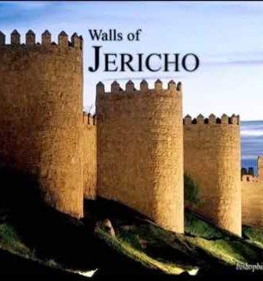
Invasion And Conquest
So when the people set out from their tents to pass over the Jordan with the priests bearing the ark of the covenant before the people, and as soon as those bearing the ark had come as far as the Jordan, and the feet of the priests bearing the ark were dipped in the brink of the water (now the Jordan overflows all its banks throughout the time of harvest), the waters coming down from above stood and rose up in a heap very far away, at Adam, the city that is beside Zarethan, and those flowing down toward the Sea of the Arabah, the Salt Sea, were completely cut off. And the people passed over opposite Jericho. Now the priests bearing the ark of the covenant of the LORD stood firmly on dry ground in the midst of the Jordan, and all Israel was passing over on dry ground until all the nation finished passing over the Jordan. (Joshua 3:14-17)

Slide 15
Invasion And Conquest
And they burned the city with fire, and everything in it. Only the silver and gold, and the vessels of bronze and of iron, they put into the treasury of the house of the LORD. But Rahab the prostitute and her father's household and all who belonged to her, Joshua saved alive. And she has lived in Israel to this day, because she hid the messengers whom Joshua sent to spy out Jericho. (Joshua 6:24-25)

Slide 16
Invasion And Conquest
And Joshua said, “Why did you bring trouble on us? The LORD brings trouble on you today.” And all Israel stoned him with stones. They burned them with fire and stoned them with stones. (Joshua 7:25)

Slide 17
Invasion And Conquest
And as they fled before Israel, while they were going down the ascent of Beth-horon, the LORD threw down large stones from heaven on them as far as Azekah, and they died. There were more who died because of the hailstones than the sons of Israel killed with the sword. At that time Joshua spoke to the LORD in the day when the LORD gave the Amorites over to the sons of Israel, and he said in the sight of Israel, “Sun, stand still at Gibeon, and moon, in the Valley of Aijalon.” And the sun stood still, and the moon stopped, until the nation took vengeance on their enemies. Is this not written in the Book of Jashar? The sun stopped in the midst of heaven and did not hurry to set for about a whole day. There has been no day like it before or since, when the LORD heeded the voice of a man, for the LORD fought for Israel. (Joshua 10:11-14)

Slide 18
Invasion And Conquest
“Now therefore fear the LORD and serve him in sincerity and in faithfulness. Put away the gods that your fathers served beyond the River and in Egypt, and serve the LORD. And if it is evil in your eyes to serve the LORD, choose this day whom you will serve, whether the gods your fathers served in the region beyond the River, or the gods of the Amorites in whose land you dwell. But as for me and my house, we will serve the LORD.” (Joshua 24:14-15)

Slide 19
Invasion And Conquest
“Speak to the people of Israel and say to them, When you pass over the Jordan into the land of Canaan, then you shall drive out all the inhabitants of the land from before you and destroy all their figured stones and destroy all their metal images and demolish all their high places. And you shall take possession of the land and settle in it, for I have given the land to you to possess it… But if you do not drive out the inhabitants of the land from before you, then those of them whom you let remain shall be as barbs in your eyes and thorns in your sides, and they shall trouble you in the land where you dwell. And I will do to you as I thought to do to them.” (Numbers 33:51-56)

Slide 20
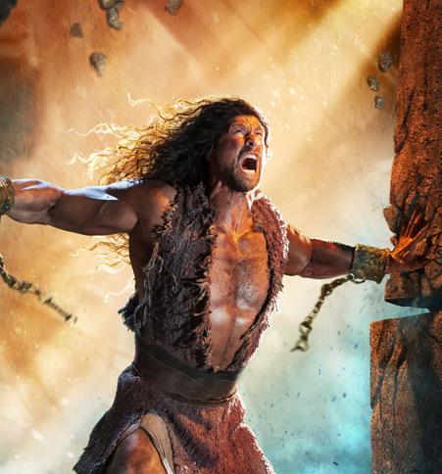
The Judges
And the people served the LORD all the days of Joshua, and all the days of the elders who outlived Joshua, who had seen all the great work that the LORD had done for Israel… And all that generation also were gathered to their fathers. And there arose another generation after them who did not know the LORD or the work that he had done for Israel. (Judges 2:7, 10)

Slide 21
The Judges
When Israel grew strong, they put the Canaanites to forced labor, but did not drive them out completely.
(Judges 1:28)

Slide 22
The Judges
They abandoned the LORD and served the Baals and the Ashtaroth. So the anger of the LORD was kindled against Israel, and he gave them over to plunderers, who plundered them. And he sold them into the hand of their surrounding enemies, so that they could no longer withstand their enemies. Whenever they marched out, the hand of the LORD was against them for harm, as the LORD had warned, and as the LORD had sworn to them. And they were in terrible distress.
(Judges 2:13-15)

Slide 23
The Judges
Then the LORD raised up judges, who saved them out of the hand of those who plundered them. Yet they did not listen to their judges, for they whored after other gods and bowed down to them. They soon turned aside from the way in which their fathers had walked, who had obeyed the commandments of the LORD, and they did not do so. Whenever the LORD raised up judges for them, the LORD was with the judge, and he saved them from the hand of their enemies all the days of the judge. For the LORD was moved to pity by their groaning because of those who afflicted and oppressed them. But whenever the judge died, they turned back and were more corrupt than their fathers, going after other gods, serving them and bowing down to them. They did not drop any of their practices or their stubborn ways.
(Judges 2:16-19)

Slide 24
The Judges
Then all the elders of Israel gathered together and came to Samuel at Ramah and said to him, “Behold, you are old and your sons do not walk in your ways. Now appoint for us a king to judge us like all the nations.” But the thing displeased Samuel when they said, “Give us a king to judge us.” And Samuel prayed to the LORD. And the LORD said to Samuel, “Obey the voice of the people in all that they say to you, for they have not rejected you, but they have rejected me from being king over them. (I Samuel 8:4-7)

Slide 25
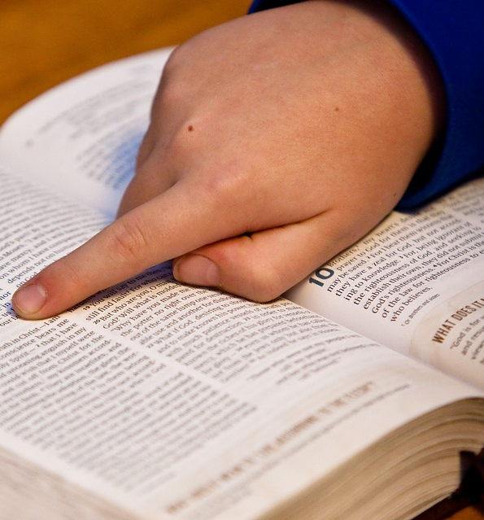
Lessons From The Biblical Narrative
Tempted to look back? Remember your salvation. Live in grace! (Heb. 10:32-36)

Slide 26
But recall the former days when, after you were enlightened, you endured a hard struggle with sufferings, sometimes being publicly exposed to reproach and affliction, and sometimes being partners with those so treated. For you had compassion on those in prison, and you joyfully accepted the plundering of your property, since you knew that you yourselves had a better possession and an abiding one. Therefore do not throw away your confidence, which has a great reward. For you have need of endurance, so that when you have done the will of God you may receive what is promised. (Hebrews 10:32-36)

Slide 27
Lessons From The Biblical Narrative
Tempted to look back? Remember your salvation. Live in grace! (Heb. 10:32-36)
God is holy. His people will be a holy people unto Him (1 Peter 1:12-16)

Slide 28
Therefore, preparing your minds for action, and being sober-minded, set your hope fully on the grace that will be brought to you at the revelation of Jesus Christ. As obedient children, do not be conformed to the passions of your former ignorance, but as he who called you is holy, you also be holy in all your conduct, since it is written, “You shall be holy, for I am holy.” (I Peter 1:13-16)

Slide 29
Lessons From The Biblical Narrative
Tempted to look back? Remember your salvation. Live in grace! (Heb. 10:32-36)
God is holy. His people will be a holy people unto Him (1 Peter 1:12-16)
God’s authority must be respected and His pattern followed (Josh 1:6-9; 2 John 9)

Slide 30
Only be strong and very courageous, being careful to do according to all the law that Moses my servant commanded you. Do not turn from it to the right hand or to the left, that you may have good success wherever you go. This Book of the Law shall not depart from your mouth, but you shall meditate on it day and night, so that you may be careful to do according to all that is written in it. For then you will make your way prosperous, and then you will have good success. (Joshua 1:7-8)
Everyone who goes on ahead and does not abide in the teaching of Christ, does not have God. Whoever abides in the teaching has both the Father and the Son. (2 John 9)

Slide 31
Lessons From The Biblical Narrative
Tempted to look back? Remember your salvation. Live in grace! (Heb. 10:32-36)
God is holy. His people will be a holy people unto Him (1 Peter 1:12-16)
God’s authority must be respected and His pattern followed (Josh 1:6-9; 2 John 9)
God deserves our complete trust and surrender to His will (I Peter 1:8-9)

Slide 32
Though you have not seen him, you love him. Though you do not now see him, you believe in him and rejoice with joy that is inexpressible and filled with glory, obtaining the outcome of your faith, the salvation of your souls. (I Peter 1:8-9)

Slide 33
Lessons From The Biblical Narrative
Tempted to look back? Remember your salvation. Live in grace! (Heb. 10:32-36)
God is holy. His people will be a holy people unto Him (1 Peter 1:12-16)
God’s authority must be respected and His pattern followed (Josh 1:6-9; 2 John 9)
God deserves our complete trust and surrender to His will (I Peter 1:8-9)
We must take seriously the worldly influences around us (2 Cor. 6:14-18)

Slide 34
Do not be unequally yoked with unbelievers. For what partnership has righteousness with lawlessness? Or what fellowship has light with darkness? What accord has Christ with Belial? Or what portion does a believer share with an unbeliever? What agreement has the temple of God with idols? For we are the temple of the living God; as God said, “I will make my dwelling among them and walk among them, and I will be their God, and they shall be my people. Therefore go out from their midst, and be separate from them, says the Lord, and touch no unclean thing; then I will welcome you, and I will be a father to you, and you shall be sons and daughters to me, says the Lord Almighty.” (2 Corinthians 6:14-18)

Slide 35
Lessons From The Biblical Narrative
Tempted to look back? Remember your salvation. Live in grace! (Heb. 10:32-36)
God is holy. His people will be a holy people unto Him (1 Peter 1:12-16)
God’s authority must be respected and His pattern followed (Josh 1:6-9; 2 John 9)
God deserves our complete trust and surrender to His will (I Peter 1:8-9)
We must take seriously the worldly influences around us (2 Cor. 6:14-18)
See humanity’s struggle – Turn away from God in times of prosperity and turn to God in times of trials (Romans 8:5-6)

Slide 36
For those who live according to the flesh set their minds on the things of the flesh, but those who live according to the Spirit set their minds on the things of the Spirit. For to set the mind on the flesh is death, but to set the mind on the Spirit is life and peace. (Romans 8:5-6)

Slide 37

If you cut the Bible open at any point it will bleed Jesus Christ
And he said to them, “O foolish ones, and slow of heart to believe all that the prophets have spoken! Was it not necessary that the Christ should suffer these things and enter into his glory?” And beginning with Moses and all the Prophets, he interpreted to them in all the Scriptures the things concerning himself.
(Luke 24:25-27)

Slide 38
If you cut the Bible open at any point it will bleed Jesus Christ
The fiery serpents… Look upon Jesus and live! (John 3:14-15)
A shadow of the experiences and blessings we have in Jesus. Will we learn from them? (1 Cor. 10:1-12)
Mt Sinai was incredible. Mount Zion is even greater and Mount Zion is ours in Jesus! (Heb 12:18-24)
Jesus is leading us to an even greater rest. Let us not fall short due to unbelief (Hebrews 3)

