Slide 1
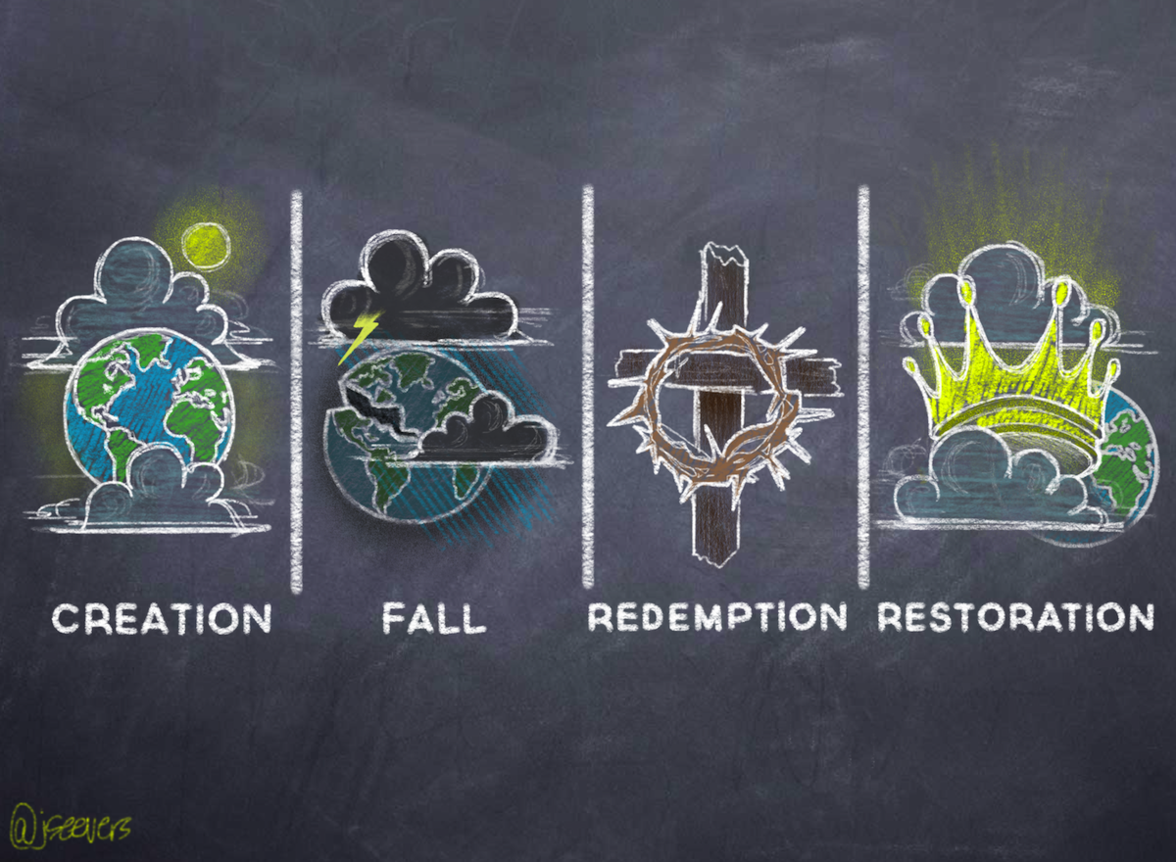
Knowing this first of all, that no prophecy of Scripture comes from someone's own interpretation. For no prophecy was ever produced by the will of man, but men spoke from God as they were carried along by the Holy Spirit. (2 Peter 1:20-21)

Slide 2
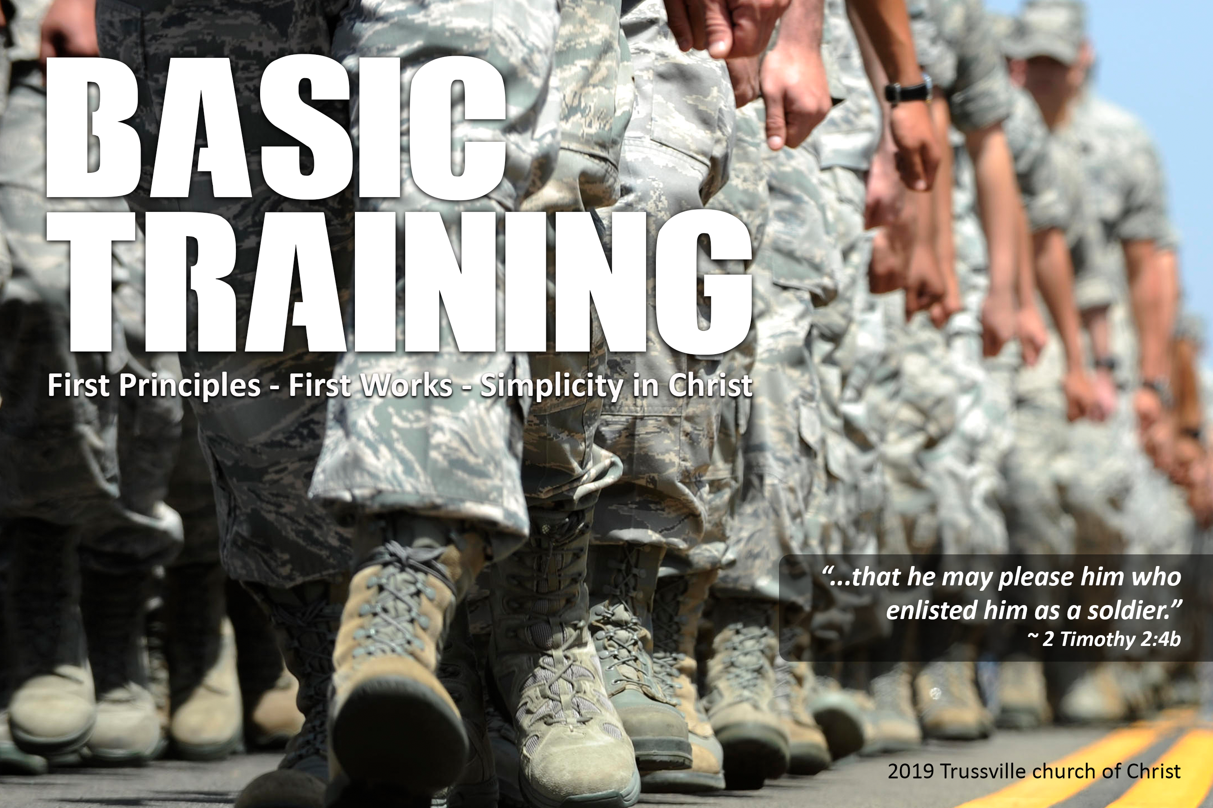

Slide 3
Seventeen Bible Time Periods
Before The Flood
The Flood
Scattering Of The People
Patriarchs
Exodus
Wandering In The Wilderness
Invasion And Conquest
Judges
United Kingdom
Divided Kingdom
Judah Alone
Captivity
Return From Captivity
Years Of Silence
Life Of Christ
Early Church
Letters To Christians

Slide 4
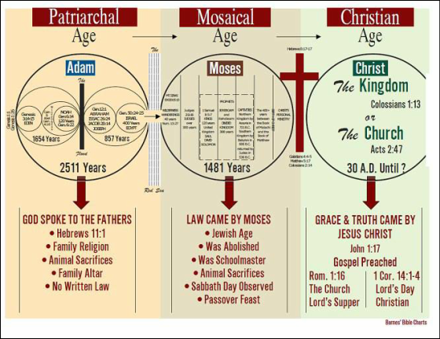
What About Gentiles?
There was no command to become Jewish proselytes to be saved. They were not judged by the law of Moses. So then what did God expect?
(Romans 1:18-21)
Only For Jews
God’s Expectations Would Have Continued Until The Resurrection

Slide 5
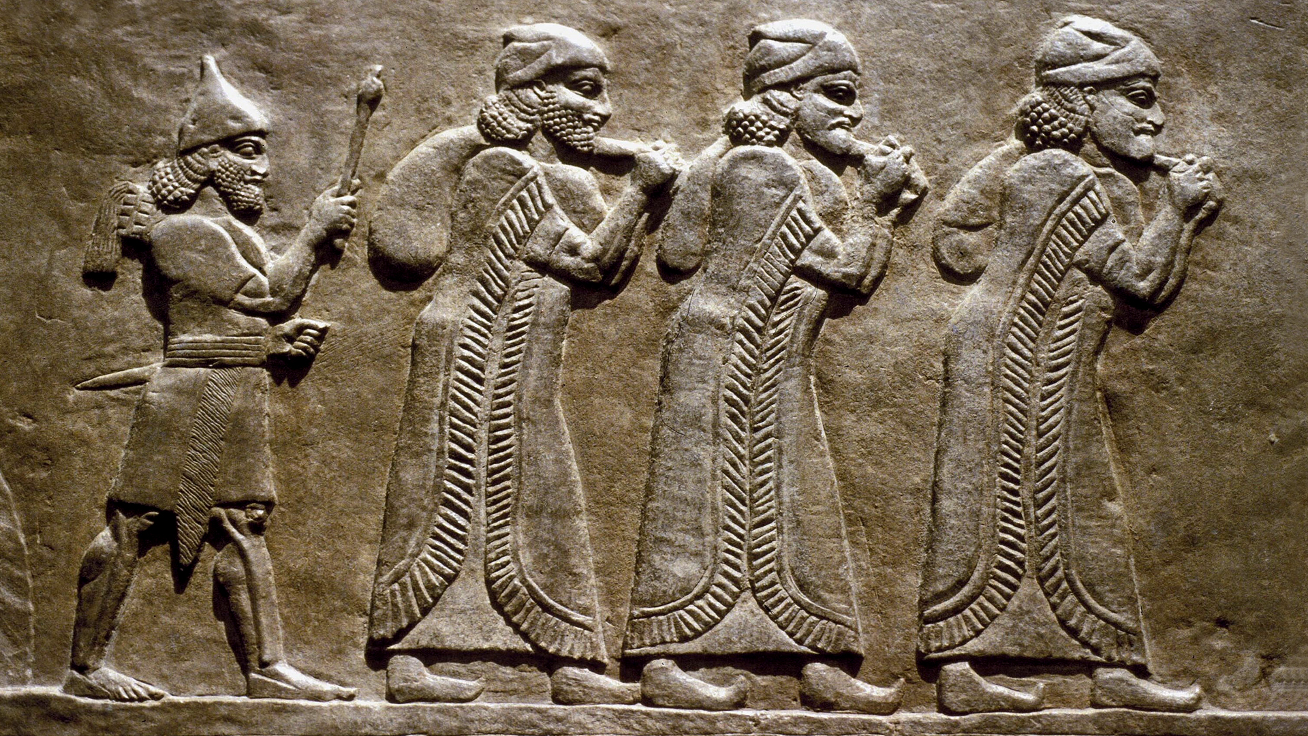
Judah Alone

Slide 6
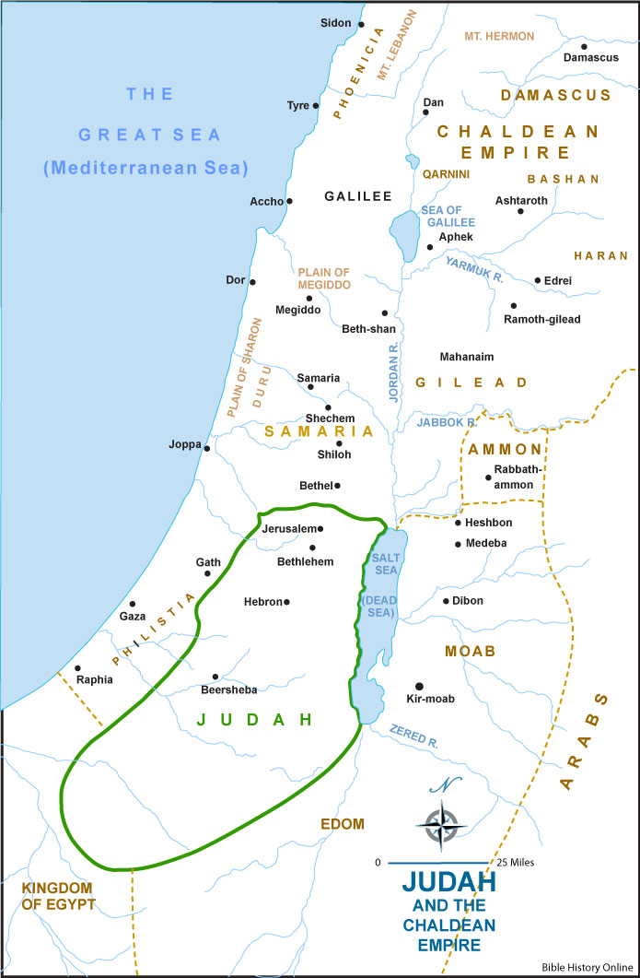
In the ninth year of Hoshea, the king of Assyria captured Samaria, and he carried the Israelites away to Assyria and placed them in Halah, and on the Habor, the river of Gozan, and in the cities of the Medes. And this occurred because the people of Israel had sinned against the LORD their God, who had brought them up out of the land of Egypt from under the hand of Pharaoh king of Egypt, and had feared other gods and walked in the customs of the nations whom the LORD drove out before the people of Israel, and in the customs that the kings of Israel had practiced. And the people of Israel did secretly against the LORD their God things that were not right. They built for themselves high places in all their towns, from watchtower to fortified city. They set up for themselves pillars and Asherim on every high hill and under every green tree…

Slide 7
…Yet the LORD warned Israel and Judah by every prophet and every seer, saying, “Turn from your evil ways and keep my commandments and my statutes, in accordance with all the Law that I commanded your fathers, and that I sent to you by my servants the prophets.” But they would not listen, but were stubborn, as their fathers had been, who did not believe in the LORD their God… And they abandoned all the commandments of the LORD their God… And they burned their sons and their daughters as offerings and used divination and omens and sold themselves to do evil in the sight of the LORD, provoking him to anger. Therefore the LORD was very angry with Israel and removed them out of his sight. None was left but the tribe of Judah only. (2 Kings 17:6-18)

Slide 8
And he did what was right in the eyes of the LORD, according to all that David his father had done. He removed the high places and broke the pillars and cut down the Asherah. And he broke in pieces the bronze serpent that Moses had made, for until those days the people of Israel had made offerings to it (it was called Nehushtan). He trusted in the LORD, the God of Israel, so that there was none like him among all the kings of Judah after him, nor among those who were before him. For he held fast to the LORD. He did not depart from following him, but kept the commandments that the LORD commanded Moses. (2 Kings 18:3-6)

Slide 9
He prayed to him, and God was moved by his entreaty and heard his plea and brought him again to Jerusalem into his kingdom. Then Manasseh knew that the LORD was God…
And he took away the foreign gods and the idol from the house of the LORD, and all the altars that he had built on the mountain of the house of the LORD and in Jerusalem, and he threw them outside of the city. He also restored the altar of the LORD and offered on it sacrifices of peace offerings and of thanksgiving, and he commanded Judah to serve the LORD, the God of Israel. (2 Chronicles 33:13, 15-16)

Slide 10
And when the king heard the words of the Law, he tore his clothes… “Go, inquire of the LORD for me and for those who are left in Israel and in Judah, concerning the words of the book that has been found. For great is the wrath of the LORD that is poured out on us, because our fathers have not kept the word of the LORD, to do according to all that is written in this book.” (2 Chron. 34:19, 21)

Slide 11
Zedekiah was twenty-one years old when he began to reign, and he reigned eleven years in Jerusalem. He did what was evil in the sight of the LORD his God. He did not humble himself before Jeremiah the prophet, who spoke from the mouth of the LORD… The LORD, the God of their fathers, sent persistently to them by his messengers, because he had compassion on his people and on his dwelling place. But they kept mocking the messengers of God, despising his words and scoffing at his prophets, until the wrath of the LORD rose against his people, until there was no remedy… He took into exile in Babylon those who had escaped from the sword, and they became servants to him and to his sons until the establishment of the kingdom of Persia, to fulfill the word of the LORD by the mouth of Jeremiah, until the land had enjoyed its Sabbaths. All the days that it lay desolate it kept Sabbath, to fulfill seventy years. (2 Chronicles 36:11-12, 15-16, 20-21)

Slide 12
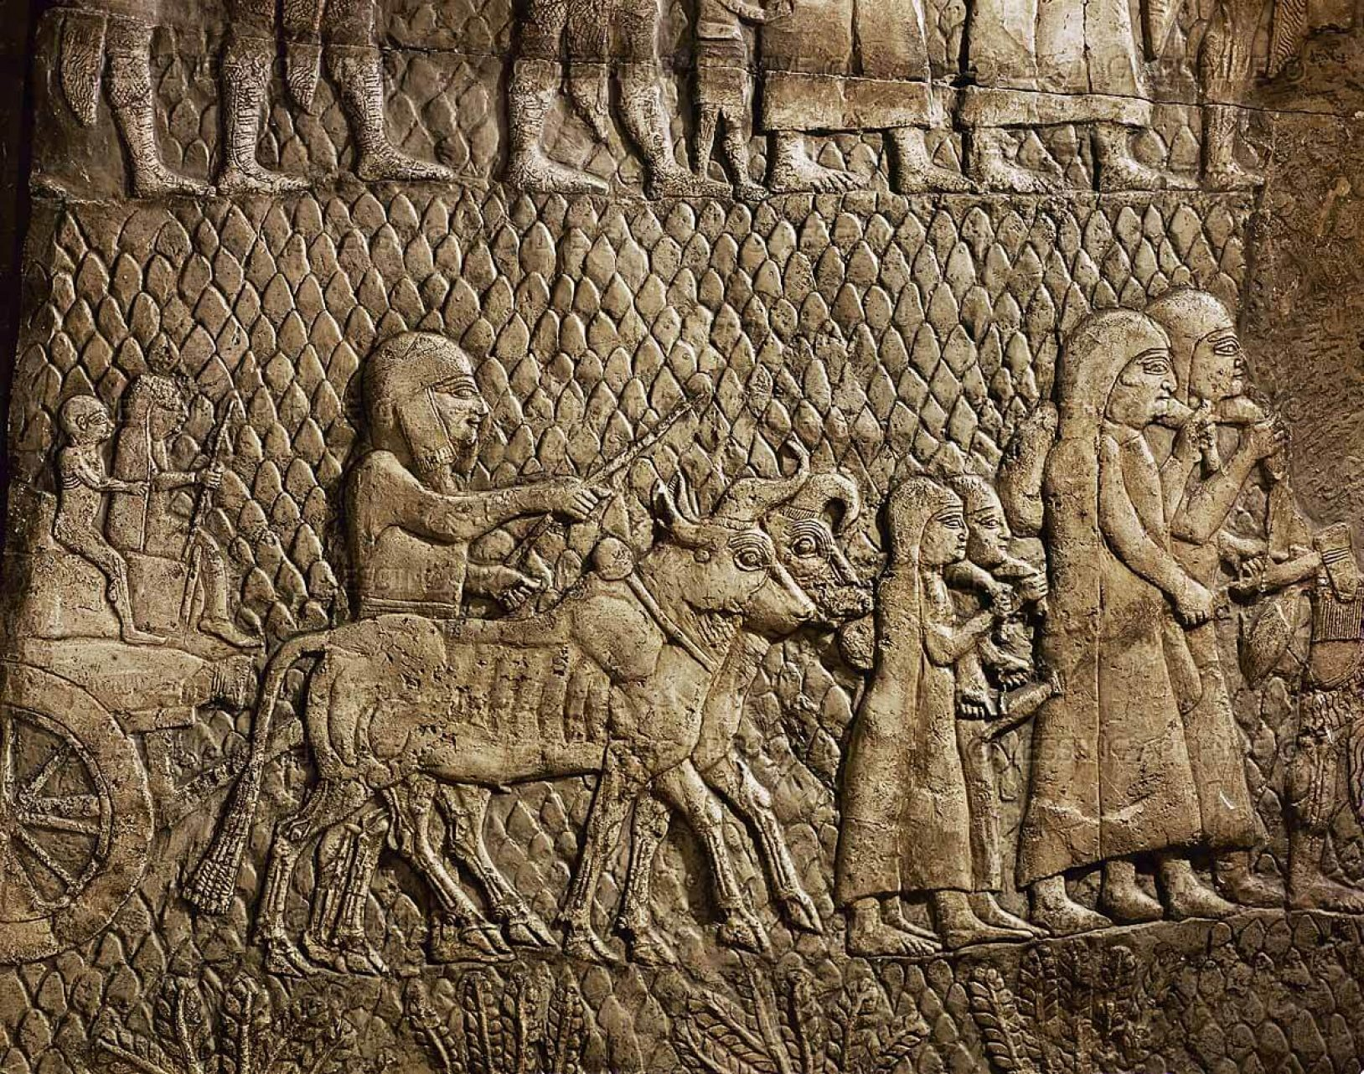
Years Of Captivity

Slide 13
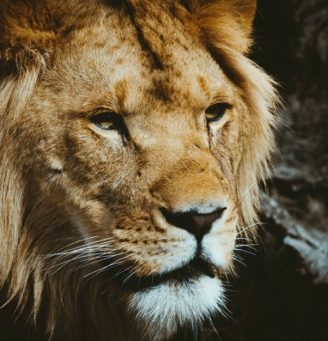
This whole land shall become a ruin and a waste, and these nations shall serve the king of Babylon seventy years. Then after seventy years are completed, I will punish the king of Babylon and that nation, the land of the Chaldeans, for their iniquity, declares the LORD, making the land an everlasting waste. (Jeremiah 25:11-12)

Slide 14
“Thus says the LORD of hosts, the God of Israel, to all the exiles whom I have sent into exile from Jerusalem to Babylon: Build houses and live in them; plant gardens and eat their produce. Take wives and have sons and daughters; take wives for your sons, and give your daughters in marriage, that they may bear sons and daughters; multiply there, and do not decrease. But seek the welfare of the city where I have sent you into exile, and pray to the LORD on its behalf, for in its welfare you will find your welfare.
(Jeremiah 29:4-7)

Slide 15
But Daniel resolved that he would not defile himself with the king's food, or with the wine that he drank. Therefore he asked the chief of the eunuchs to allow him not to defile himself. And God gave Daniel favor and compassion in the sight of the chief of the eunuchs (Daniel 1:8-9)

Slide 16
By the waters of Babylon, there we sat down and wept, when we remembered Zion. On the willows there we hung up our lyres. For there our captors required of us songs, and our tormentors, mirth, saying, “Sing us one of the songs of Zion!” How shall we sing the LORD's song in a foreign land? If I forget you, O Jerusalem, let my right hand forget its skill!
(Psalm 137:1-5)

Slide 17
In the first year of Cyrus king of Persia, that the word of the LORD by the mouth of Jeremiah might be fulfilled, the LORD stirred up the spirit of Cyrus king of Persia, so that he made a proclamation throughout all his kingdom and also put it in writing: “Thus says Cyrus king of Persia: The LORD, the God of heaven, has given me all the kingdoms of the earth, and he has charged me to build him a house at Jerusalem, which is in Judah. Whoever is among you of all his people, may his God be with him, and let him go up to Jerusalem, which is in Judah, and rebuild the house of the LORD, the God of Israel — he is the God who is in Jerusalem.
(Ezra 1:1-3)

Slide 18
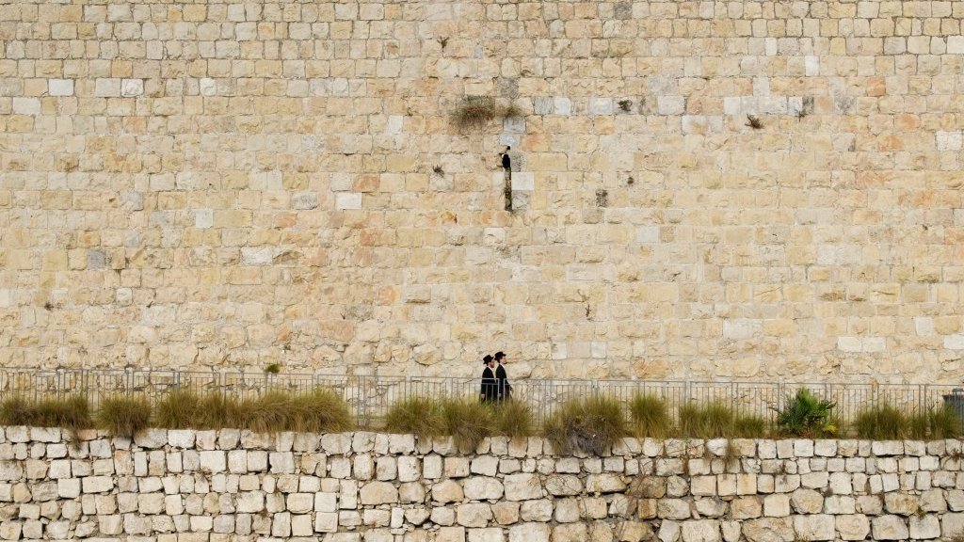
Return From Captivity

Slide 19
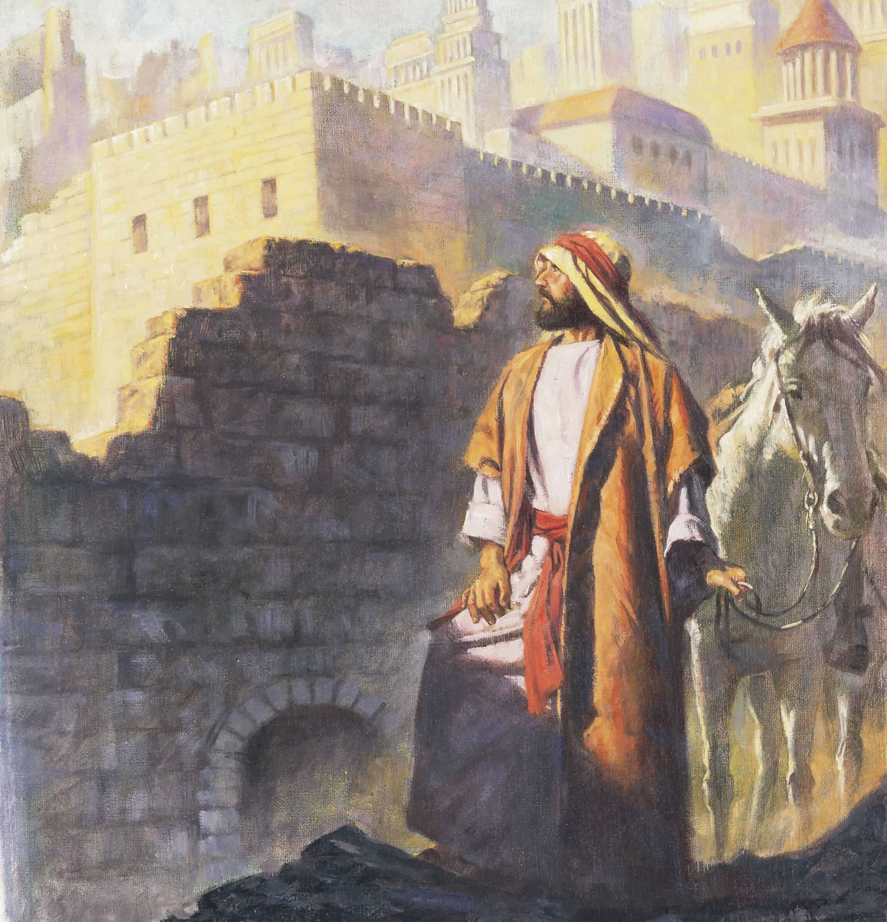
Now in the second year after their coming to the house of God at Jerusalem, in the second month, Zerubbabel the son of Shealtiel and Jeshua the son of Jozadak made a beginning, together with the rest of their kinsmen, the priests and the Levites and all who had come to Jerusalem from the captivity. They appointed the Levites, from twenty years old and upward, to supervise the work of the house of the LORD. (Ezra 3:8)
Zerubbabel

Slide 20
And they sang responsively, praising and giving thanks to the LORD, “For he is good, for his steadfast love endures forever toward Israel.” And all the people shouted with a great shout when they praised the LORD, because the foundation of the house of the LORD was laid. But many of the priests and Levites and heads of fathers' houses, old men who had seen the first house, wept with a loud voice when they saw the foundation of this house being laid, though many shouted aloud for joy, so that the people could not distinguish the sound of the joyful shout from the sound of the people's weeping, for the people shouted with a great shout, and the sound was heard far away. (vs. 11-13)
Zerubbabel

Slide 21
and this house was finished on the third day of the month of Adar, in the sixth year of the reign of Darius the king.
(Ezra 6:15)
Zerubbabel

Slide 22
this Ezra went up from Babylonia. He was a scribe skilled in the Law of Moses that the LORD, the God of Israel, had given, and the king granted him all that he asked, for the hand of the LORD his God was on him… For Ezra had set his heart to study the Law of the LORD, and to do it and to teach his statutes and rules in Israel. (Ezra 7:6, 10)
While Ezra prayed and made confession, weeping and casting himself down before the house of God, a very great assembly of men, women, and children, gathered to him out of Israel, for the people wept bitterly. And Shecaniah the son of Jehiel, of the sons of Elam, addressed Ezra: “We have broken faith with our God and have married foreign women from the peoples of the land, but even now there is hope for Israel in spite of this. (Ezra 10:1-2)
Ezra

Slide 23
So the wall was finished on the twenty-fifth day of the month Elul, in fifty-two days. And when all our enemies heard of it, all the nations around us were afraid and fell greatly in their own esteem, for they perceived that this work had been accomplished with the help of our God (Neh 6:15-16)
Nehemiah

Slide 24
And I was very angry, and I threw all the household furniture of Tobiah out of the chamber. Then I gave orders, and they cleansed the chambers, and I brought back there the vessels of the house of God, with the grain offering and the frankincense… As soon as it began to grow dark at the gates of Jerusalem before the Sabbath, I commanded that the doors should be shut and gave orders that they should not be opened until after the Sabbath. And I stationed some of my servants at the gates, that no load might be brought in on the Sabbath day. Then the merchants and sellers of all kinds of wares lodged outside Jerusalem once or twice. But I warned them and said to them, “Why do you lodge outside the wall? If you do so again, I will lay hands on you.” From that time on they did not come on the Sabbath… And I confronted them and cursed them and beat some of them and pulled out their hair. And I made them take an oath in the name of God, saying, “You shall not give your daughters to their sons, or take their daughters for your sons or for yourselves. (13)
Nehemiah

Slide 25
Then Mordecai told them to reply to Esther, “Do not think to yourself that in the king's palace you will escape any more than all the other Jews. For if you keep silent at this time, relief and deliverance will rise for the Jews from another place, but you and your father's house will perish. And who knows whether you have not come to the kingdom for such a time as this?” Then Esther told them to reply to Mordecai, “Go, gather all the Jews to be found in Susa, and hold a fast on my behalf, and do not eat or drink for three days, night or day. I and my young women will also fast as you do. Then I will go to the king, though it is against the law, and if I perish, I perish.”
(Esther 4:13-16)
Esther

Slide 26

Sin is that serious. If we continue in it, we will face judgment from God regardless of who we are or our past (Romans 2:3-5)
Even when it seems no one cares, God has a remnant who lives by hope and walks by faith. This remnant is the hope of the lost! (Jeremiah 31:7-9)
See the character of penitent people. Willing to repent and change. Hungry for the scriptures. Committed to getting it right (Neh 8:5-6; Ezra 2:62)
An example for God’s strangers and pilgrims today… In the world, not of the world (Jn 17:14-17; I Pet 2:11-12)
While we do not know what God is doing in His providence, we are vessels in His service wherever we are in life (2 Timothy 2:21)

Slide 27

The Scarlet Thread
woven through the tapestry of scripture
See the problem of sin… man is in desperate need of a Savior (Rom 3:23)
Jeremiah spoke with hope of a coming Messiah (Jer. 23:5-6) and the new covenant He would bring (31:33-34)
Daniel revealed a glimpse of the kingdom that was coming greater than all earthly kingdoms (Daniel 2:44-45)

