Slide 1
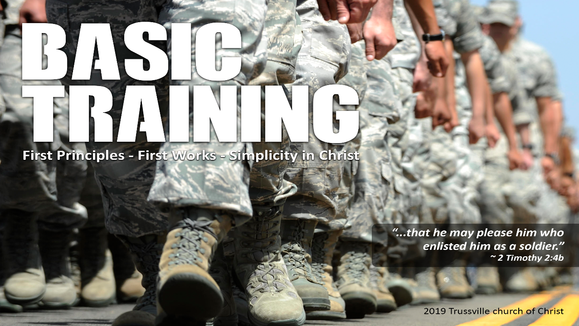

Slide 2
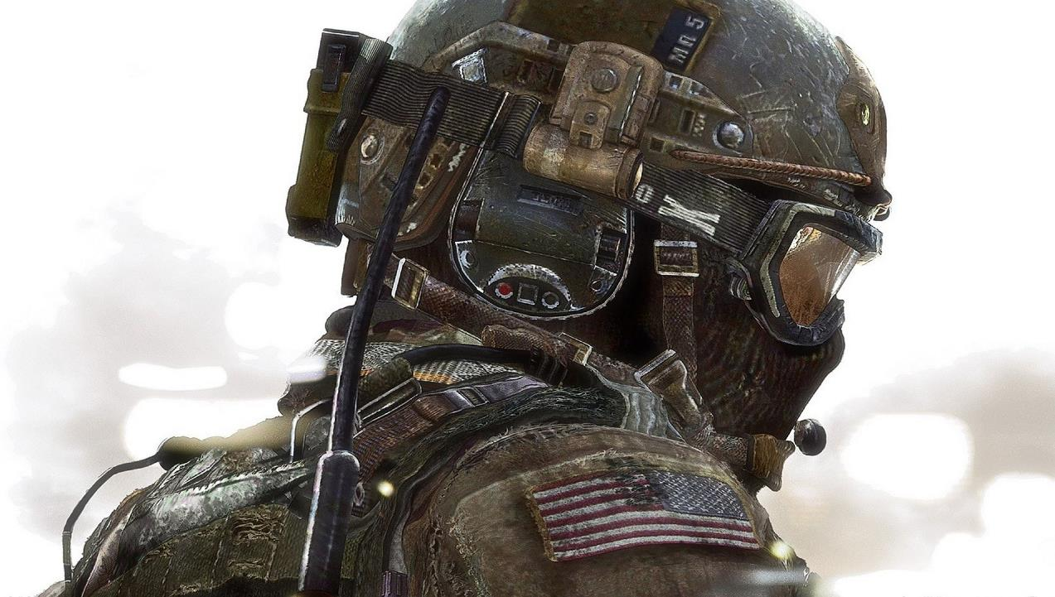
The Bible
The Soldier’s Manual

Slide 3
Seventeen Time Periods
Before The Flood
The Flood
Scattering Of The People
Patriarchs
Exodus
Wandering In The Wilderness
Invasion And Conquest
Judges
United Kingdom
Divided Kingdom
Judah Alone
Captivity
Return From Captivity
Years Of Silence
Life Of Christ
Early Church
Letters To Christians

Slide 4

Over 1400 Years
Over 40 Generations
Over 40 Authors
Different cultures, Different Languages, Different Lands
One Continuous
Storyline

Slide 5
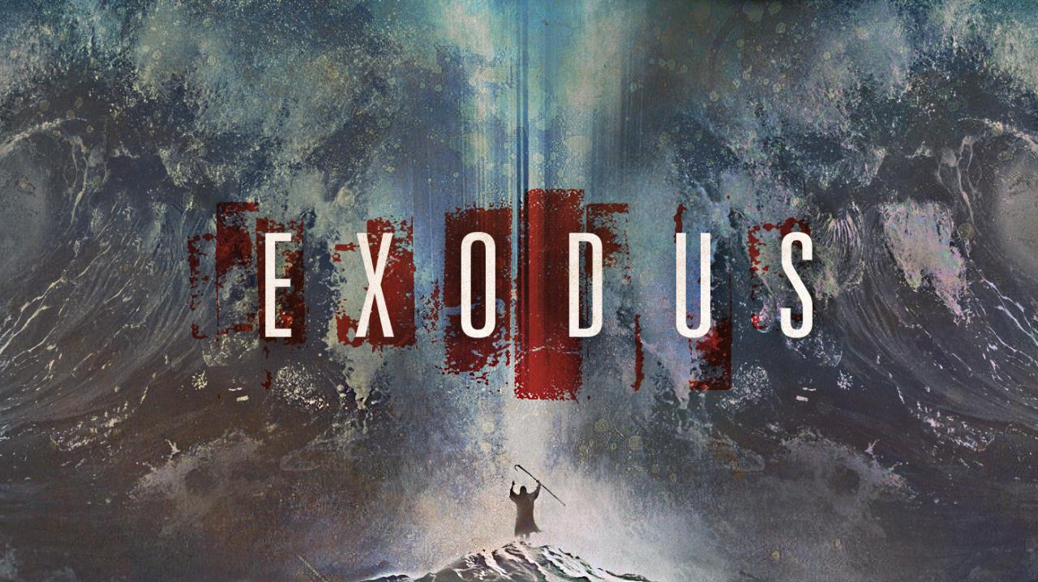

Slide 6
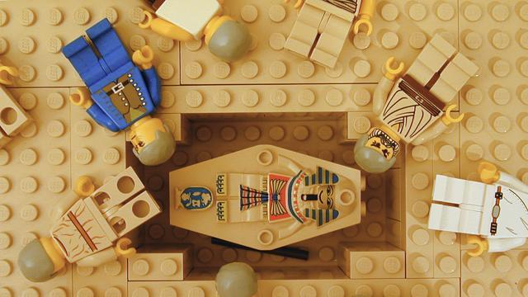

Slide 7
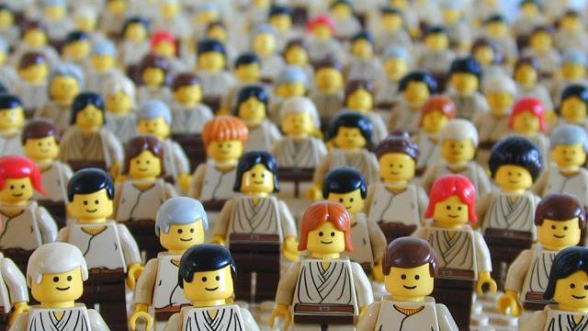

Slide 8
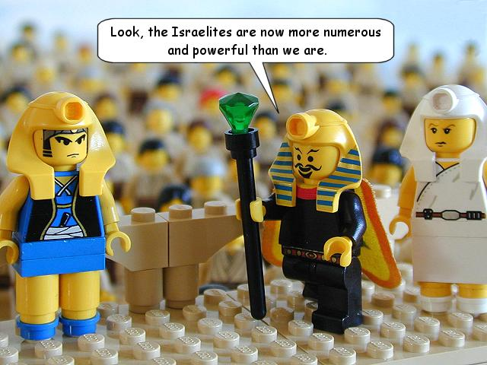

Slide 9
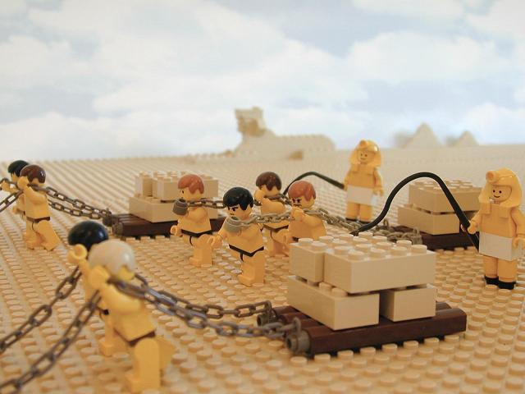
Now there arose a new king over Egypt, who did not know Joseph. And he said to his people, “Behold, the people of Israel are too many and too mighty for us. Come, let us deal shrewdly with them, lest they multiply, and, if war breaks out, they join our enemies and fight against us and escape from the land.” (Exodus 1:8-10)
The new Pharaoh stayed suspicious of God’s people. They were greatly oppressed

Slide 10
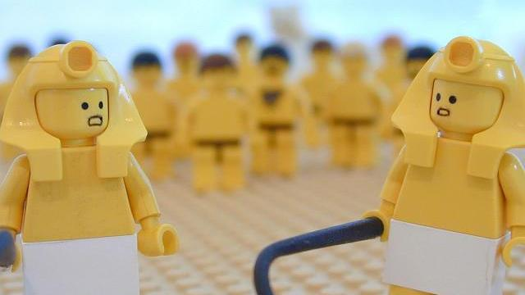

Slide 11
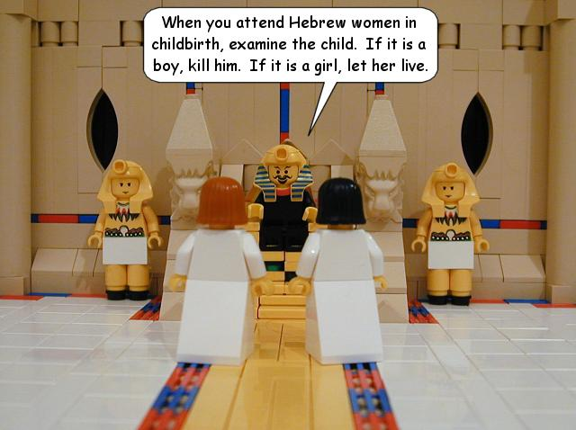
Therefore they set taskmasters over them to afflict them with heavy burdens. They built for Pharaoh store cities, Pithom and Raamses. But the more they were oppressed, the more they multiplied and the more they spread abroad. And the Egyptians were in dread of the people of Israel. So they ruthlessly made the people of Israel work as slaves and made their lives bitter with hard service, in mortar and brick, and in all kinds of work in the field. In all their work they ruthlessly made them work as slaves. Then the king of Egypt said to the Hebrew midwives, one of whom was named Shiphrah and the other Puah, “When you serve as midwife to the Hebrew women and see them on the birthstool, if it is a son, you shall kill him, but if it is a daughter, she shall live.” (Exodus 1:11-16)
Every male child was to be killed. Only the girls were allowed to live.

Slide 12
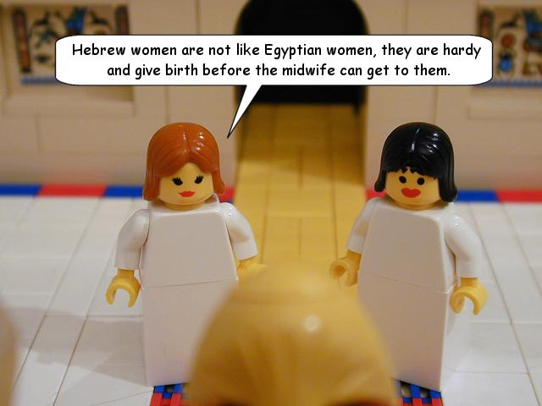

Slide 13
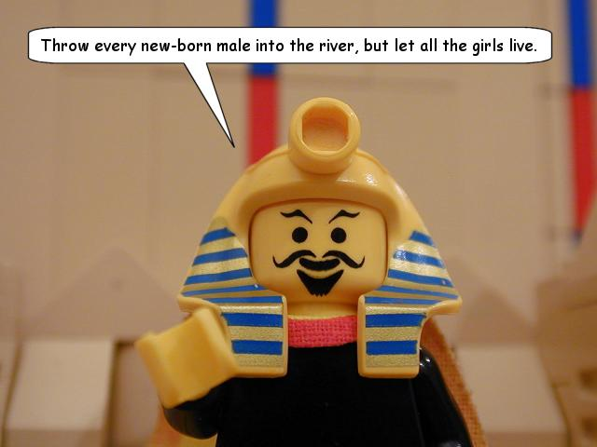

Slide 14
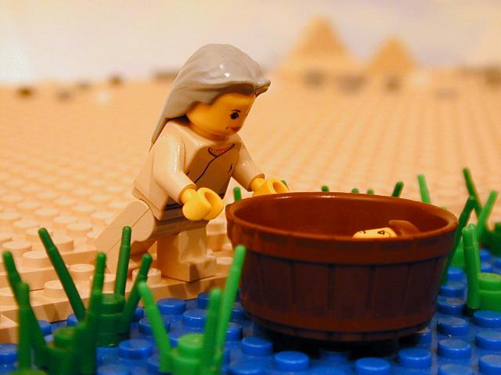
When she could hide him no longer, she took for him a basket made of bulrushes and daubed it with bitumen and pitch. She put the child in it and placed it among the reeds by the river bank. And his sister stood at a distance to know what would be done to him. Now the daughter of Pharaoh came down to bathe at the river, while her young women walked beside the river. She saw the basket among the reeds and sent her servant woman, and she took it. When she opened it, she saw the child, and behold, the baby was crying. She took pity on him and said, “This is one of the Hebrews' children.”
When Jochebed could hide Moses no longer she came up with a difficult plan

Slide 15
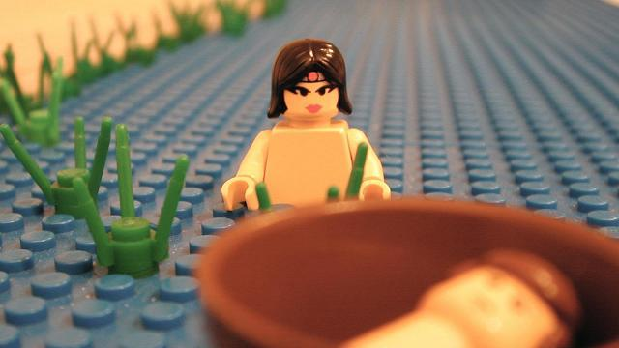

Slide 16
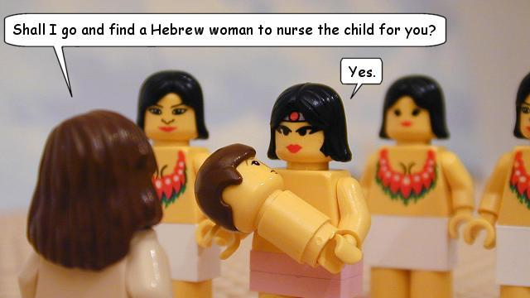

Slide 17
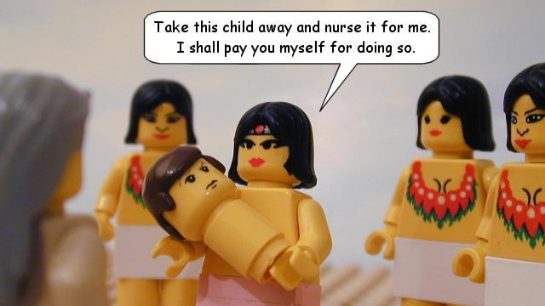

Slide 18
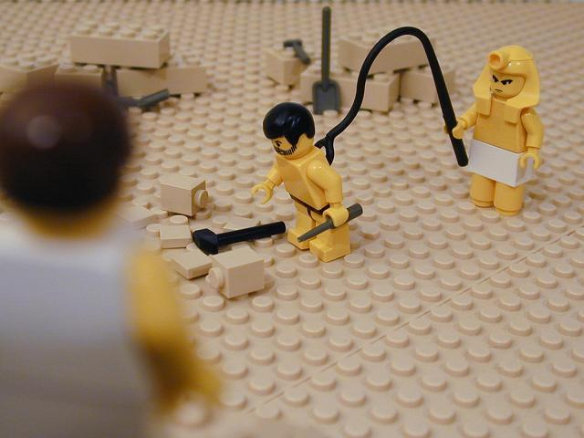
During those many days the king of Egypt died, and the people of Israel groaned because of their slavery and cried out for help. Their cry for rescue from slavery came up to God. And God heard their groaning, and God remembered his covenant with Abraham, with Isaac, and with Jacob. God saw the people of Israel —and God knew.
The oppression of God’s people intensifies. Moses can stand it no longer.

Slide 19
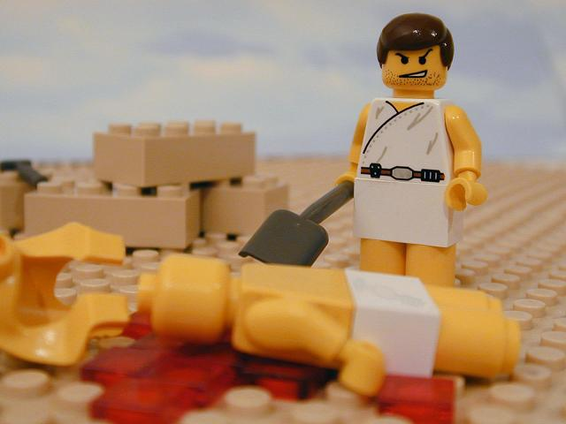

Slide 20
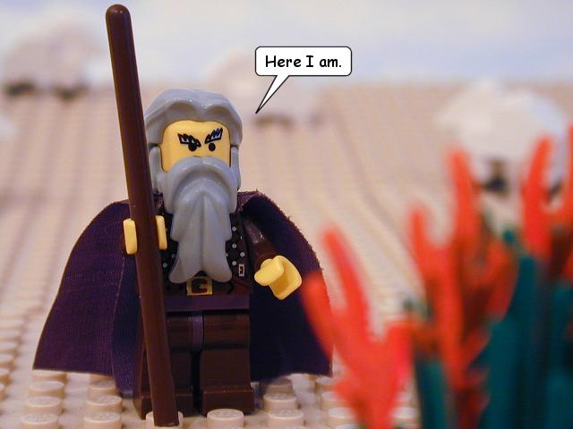
Now Moses was keeping the flock of his father-in-law, Jethro, the priest of Midian, and he led his flock to the west side of the wilderness and came to Horeb, the mountain of God. And the angel of the LORD appeared to him in a flame of fire out of the midst of a bush. He looked, and behold, the bush was burning, yet it was not consumed. And Moses said, “I will turn aside to see this great sight, why the bush is not burned.” When the LORD saw that he turned aside to see, God called to him out of the bush, “Moses, Moses!” And he said, “Here I am.” Then he said, “Do not come near; take your sandals off your feet, for the place where you are standing is holy ground.” (Exodus 3:1-5)
In Midian, God speaks to Moses through a burning bush. He would lead the people out.

Slide 21
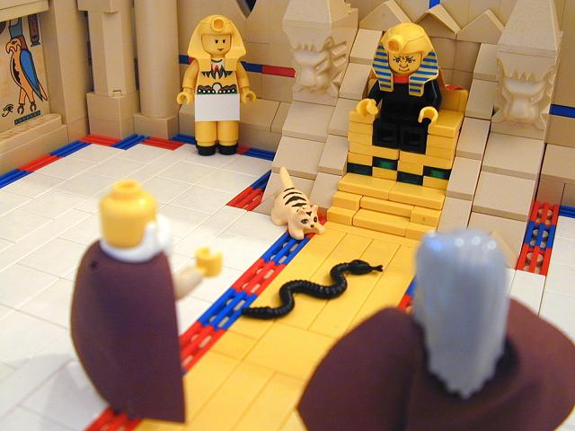
So Moses and Aaron went to Pharaoh and did just as the LORD commanded. Aaron cast down his staff before Pharaoh and his servants, and it became a serpent. Then Pharaoh summoned the wise men and the sorcerers, and they, the magicians of Egypt, also did the same by their secret arts. For each man cast down his staff, and they became serpents. But Aaron's staff swallowed up their staffs. Still Pharaoh's heart was hardened, and he would not listen to them, as the LORD had said. (Exodus 7:10-13)
Moses and Aaron appear before Pharaoh with a sign: Their staff becomes a serpent

Slide 22
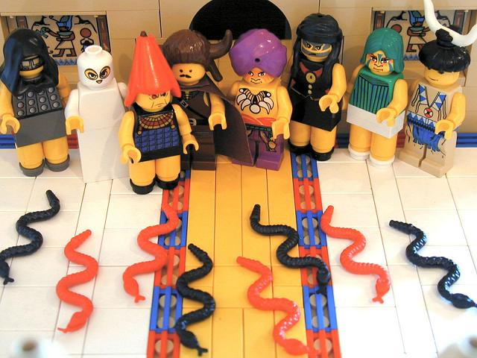

Slide 23
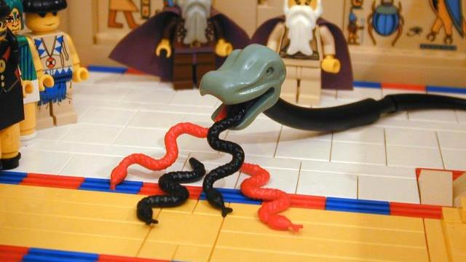

Slide 24
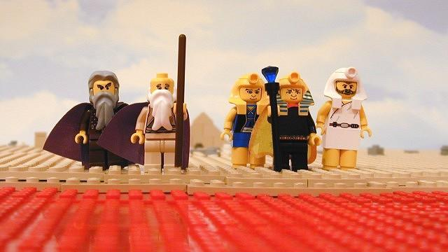

Slide 25
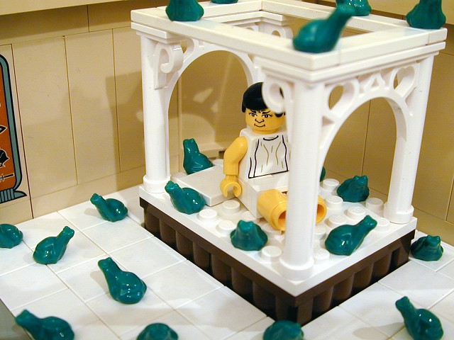

Slide 26
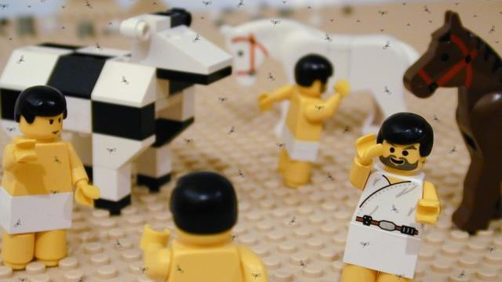

Slide 27
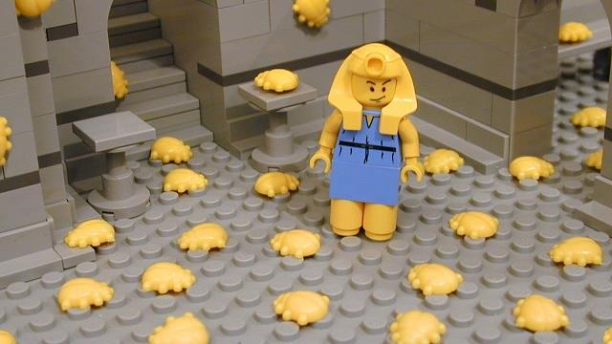

Slide 28
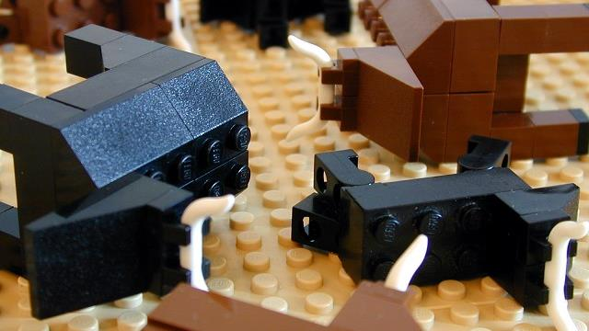

Slide 29
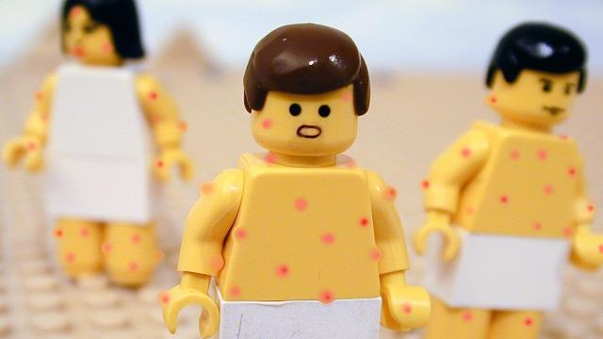

Slide 30
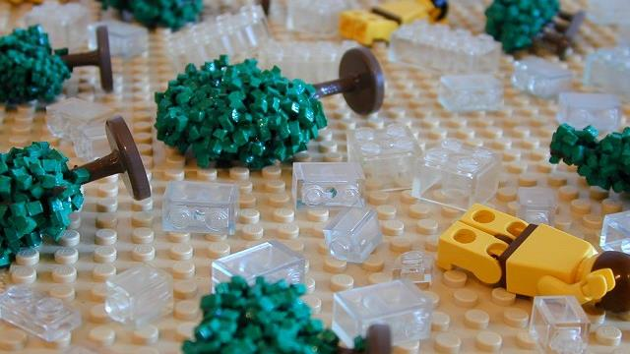

Slide 32
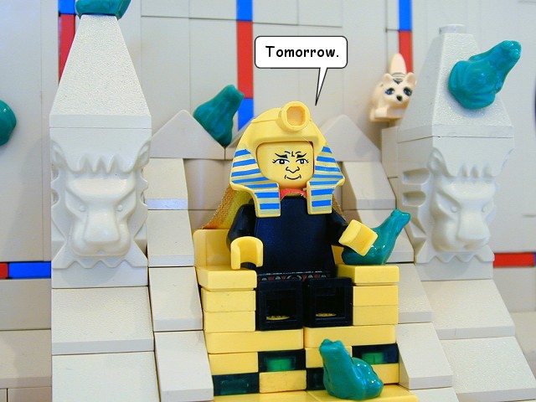
And Pharaoh sent, and behold, not one of the livestock of Israel was dead. But the heart of Pharaoh was hardened, and he did not let the people go (Exodus 9:7)
Then Pharaoh hastily called Moses and Aaron and said, “I have sinned against the LORD your God, and against you. Now therefore, forgive my sin, please, only this once, and plead with the LORD your God only to remove this death from me.” So he went out from Pharaoh and pleaded with the LORD. (Exodus 10:16-18)
With each plague and each refusal the heart of Pharaoh grew harder.

Slide 33
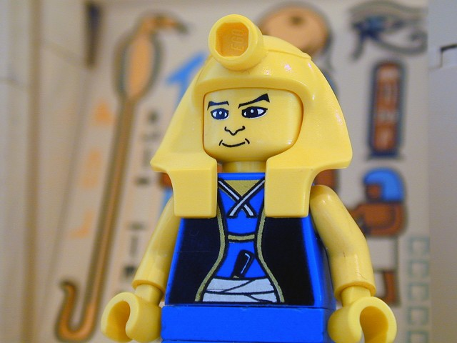
So Moses said, “Thus says the LORD: ‘About midnight I will go out in the midst of Egypt, and every firstborn in the land of Egypt shall die, from the firstborn of Pharaoh who sits on his throne, even to the firstborn of the slave girl who is behind the handmill, and all the firstborn of the cattle. There shall be a great cry throughout all the land of Egypt, such as there has never been, nor ever will be again. (Exodus 11:4-6)
One final plague. The first born of all Egypt would be dead. All of Israel would live.

Slide 34
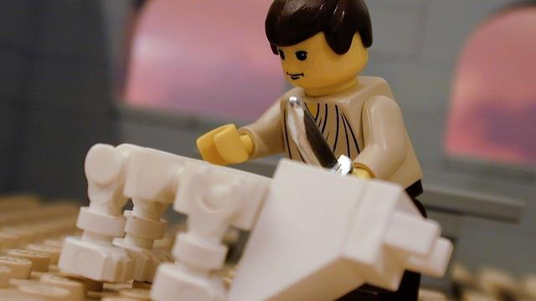

Slide 35
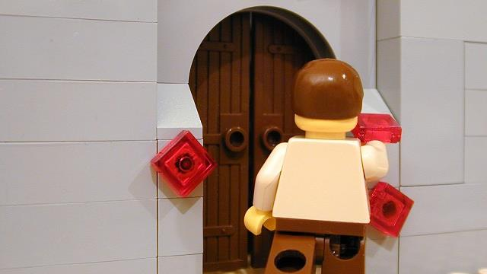

Slide 36
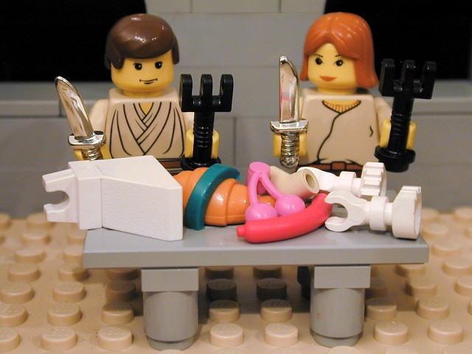
Your lamb shall be without blemish, a male a year old. You may take it from the sheep or from the goats, and you shall keep it until the fourteenth day of this month, when the whole assembly of the congregation of Israel shall kill their lambs at twilight. “Then they shall take some of the blood and put it on the two doorposts and the lintel of the houses in which they eat it. They shall eat the flesh that night, roasted on the fire; with unleavened bread and bitter herbs they shall eat it… In this manner you shall eat it: with your belt fastened, your sandals on your feet, and your staff in your hand. And you shall eat it in haste. It is the LORD's Passover (Exodus 12:5-8, 11)
They were to eat a “Passover Meal” knowing they would seen be leaving in haste.

Slide 37
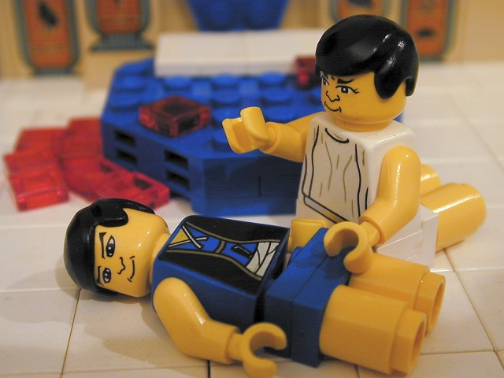
And Pharaoh rose up in the night, he and all his servants and all the Egyptians. And there was a great cry in Egypt, for there was not a house where someone was not dead. Then he summoned Moses and Aaron by night and said, “Up, go out from among my people, both you and the people of Israel; and go, serve the LORD, as you have said. Take your flocks and your herds, as you have said, and be gone, and bless me also!” (Exodus 12:30-32)
Terror Strikes The Land! At midnight all the firstborn males of all Egypt were struck dead.

Slide 38
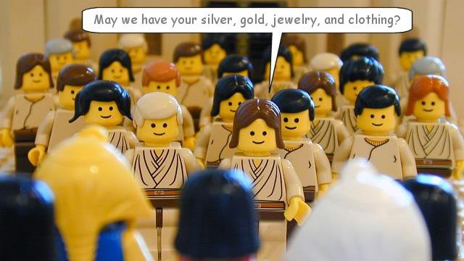

Slide 39
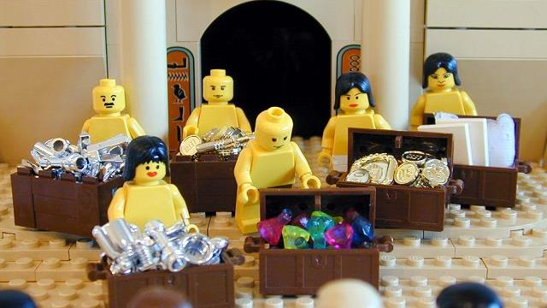

Slide 40
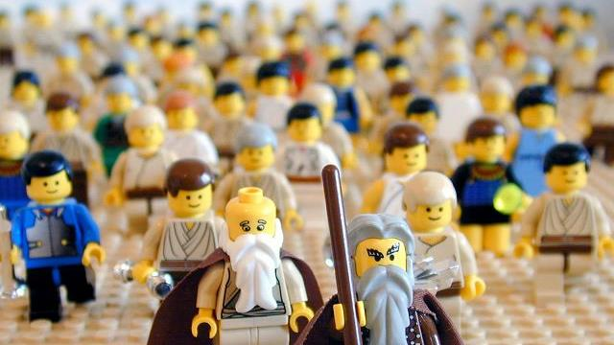

Slide 41
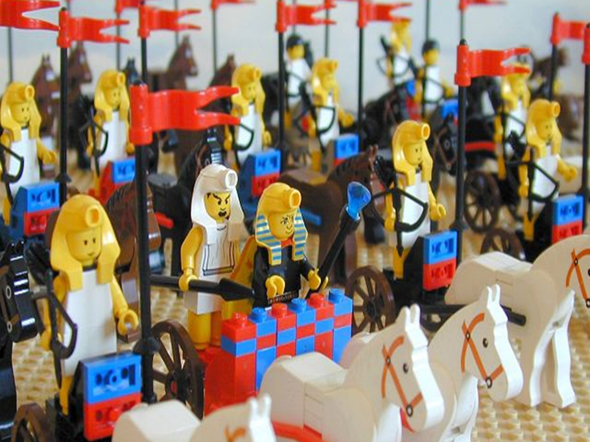
The Egyptians pursued them, all Pharaoh's horses and chariots and his horsemen and his army, and overtook them encamped at the sea, by Pi-hahiroth, in front of Baal-zephon. When Pharaoh drew near, the people of Israel lifted up their eyes, and behold, the Egyptians were marching after them, and they feared greatly. And the people of Israel cried out to the LORD.
(Exodus 14:9-10)
Pharaoh decides he is not done yet. He gathers his army to pursue Israel.

Slide 42
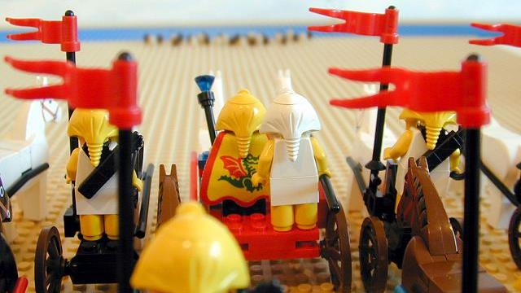

Slide 43
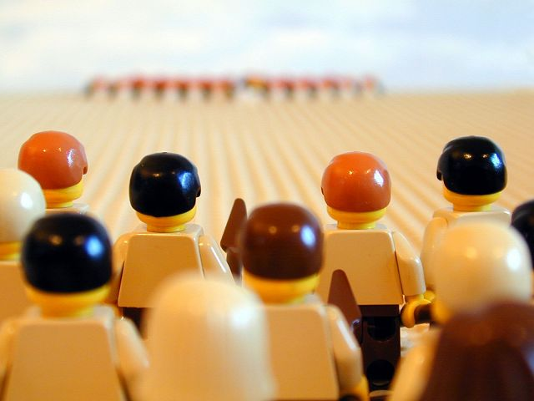

Slide 44
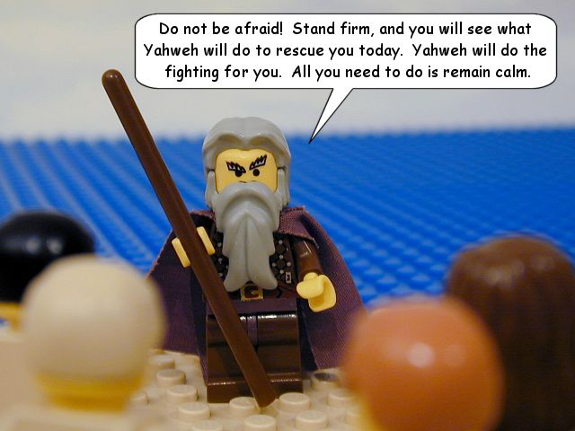
And Moses said to the people, “Fear not, stand firm, and see the salvation of the LORD, which he will work for you today. For the Egyptians whom you see today, you shall never see again. The LORD will fight for you, and you have only to be silent.”
(Exodus 14:13-14)
Moses calms the people and calls upon them to trust God for deliverance again.

Slide 45
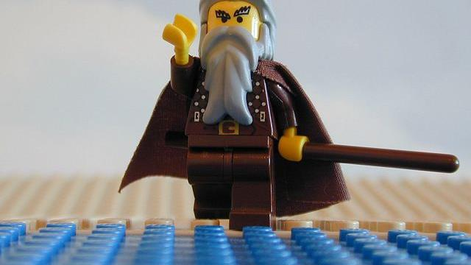

Slide 46
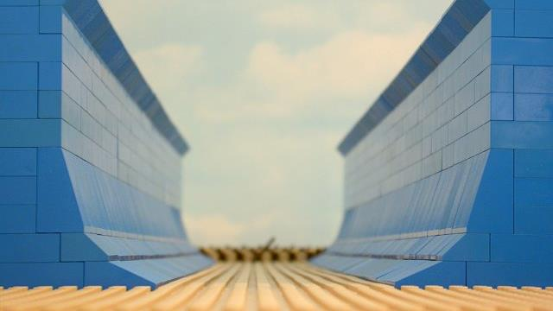

Slide 47
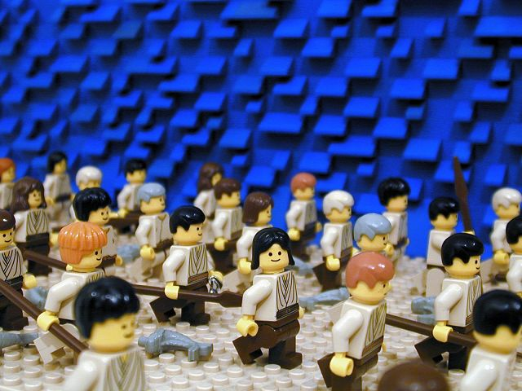
Then Moses stretched out his hand over the sea, and the LORD drove the sea back by a strong east wind all night and made the sea dry land, and the waters were divided. And the people of Israel went into the midst of the sea on dry ground, the waters being a wall to them on their right hand and on their left.
(Exodus 14:21-22)
The Israelites crossed the Red Sea on dry ground.

Slide 48
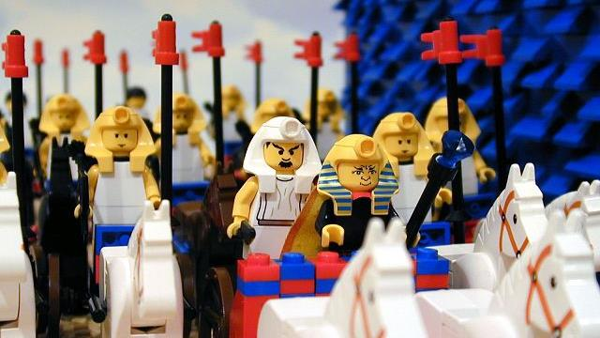

Slide 49
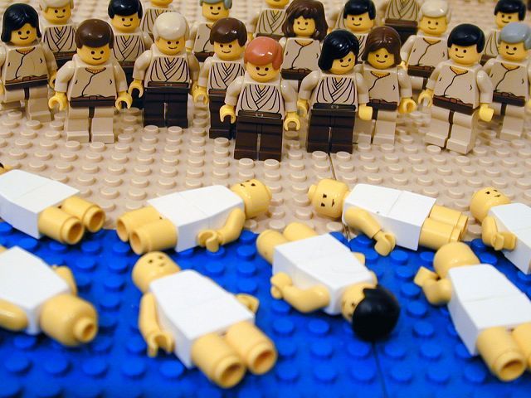
The waters returned and covered the chariots and the horsemen; of all the host of Pharaoh that had followed them into the sea, not one of them remained. But the people of Israel walked on dry ground through the sea, the waters being a wall to them on their right hand and on their left. Thus the LORD saved Israel that day from the hand of the Egyptians, and Israel saw the Egyptians dead on the seashore. Israel saw the great power that the LORD used against the Egyptians, so the people feared the LORD, and they believed in the LORD and in his servant Moses. (Exodus 14:28-31)
God closed the waters upon the Egyptians and they all drowned.

Slide 50

Timeless Lessons
- God sees and know His people (Exodus 2:25, 3:7; 2 Tim 2:19)
- We can have faith to do hard things in difficult circumstances (Hebrews 11:23)
- God is faithful. His providence, promises, and promises are sure (Hebrews 6:16-18)
- Don’t be Pharaoh. You heart can harden that hard! Stop kicking against God! (Jas 4:7-10)

Slide 51
The Scarlet Thread
- Sin puts us in bondage like the Israelites in Egypt. We are in desperate need of deliverance. Jesus saves! (Hebrews 2:14-15)
- Jesus is our Passover Lamb. His blood on the doorposts of our hearts allows God to passover our sins and failures. Is the blood applied? (Rev. 5:5-14)

