Slide 1
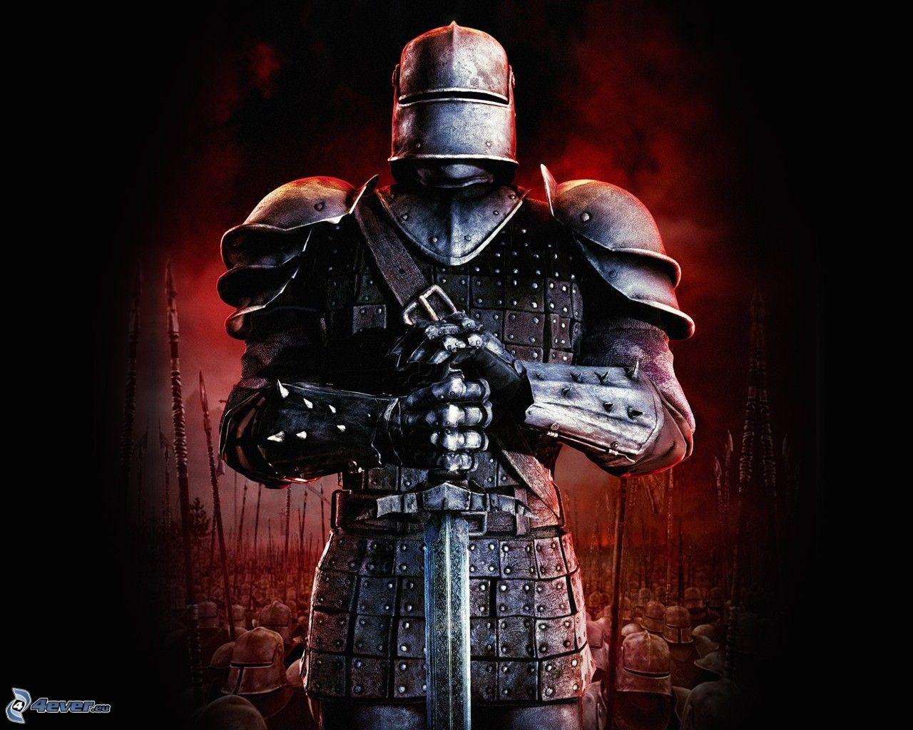
Put On
The Armor
Of God
Ephesians 6:10-20
The Sword of the Spirit

Slide 2
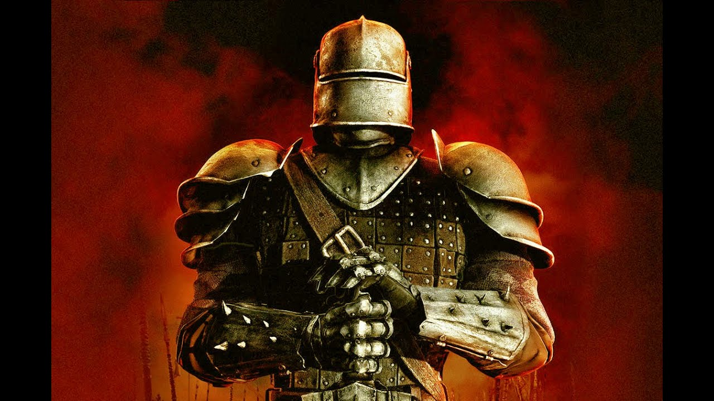
Are You Battle Ready?

Slide 3
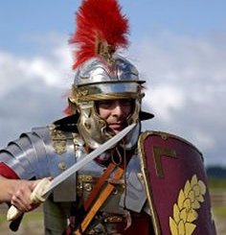
The Sword Of The Spirit
The typical weapon of the Roman soldier was a gladius sword

Slide 4
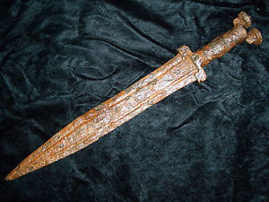
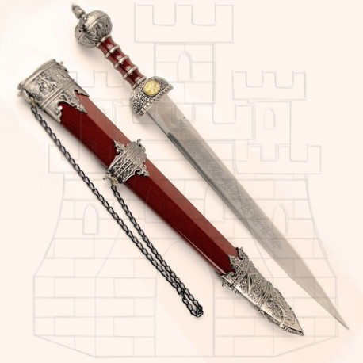
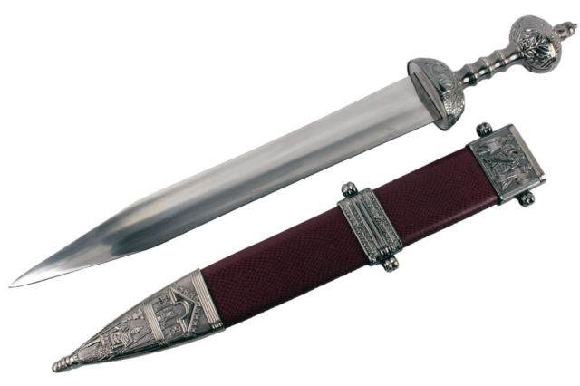
While he was still speaking, Judas came, one of the twelve, and with him a great crowd with swords and clubs, from the chief priests and the elders of the people. (Matthew 26:47)
And behold, one of those who were with Jesus stretched out his hand and drew his sword and struck the servant of the high priest and cut off his ear. (Matthew 26:51)
About that time Herod the king laid violent hands on some who belonged to the church. He killed James the brother of John with the sword (Acts 12:1-2)

Slide 5
The Sword Of The Spirit
The typical weapon of the Roman soldier was a gladius sword
God equips us for defense and attack with the sword of the Spirit, the word of God (2 Timothy 3:16-17)

Slide 6
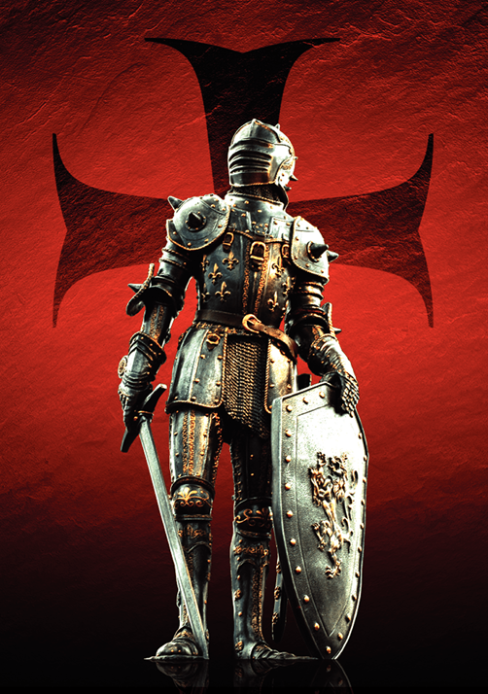
All Scripture is breathed out by God and profitable for teaching, for reproof, for correction, and for training in righteousness, that the man of God may be complete, equipped for every
good work.

Slide 7
The Sword Of The Spirit
The typical weapon of the Roman soldier was a gladius sword
God equips us for defense and attack with the sword of the Spirit, the word of God (2 Timothy 3:16-17)
To hold the scriptures, the words of our Creator, is amazing… Appreciate it!
A wonderful treasure! Guards, strengthens, establishes (Ps 119:41-48)

Slide 8
Let your steadfast love come to me, O LORD, your salvation according to your promise;
then shall I have an answer for him who taunts me, for I trust in your word.
And take not the word of truth utterly out of my mouth, for my hope is in your rules.
I will keep your law continually, forever and ever,
and I shall walk in a wide place, for I have sought your precepts.
I will also speak of your testimonies before kings and shall not be put to shame,
for I find my delight in your commandments, which I love.
I will lift up my hands toward your commandments, which I love, and I will meditate on your statutes.

Slide 9
The Sword Of The Spirit
The typical weapon of the Roman soldier was a gladius sword
God equips us for defense and attack with the sword of the Spirit, the word of God (2 Timothy 3:16-17)
To hold the scriptures, the words of our Creator, is amazing… Appreciate it!
A wonderful treasure! Guards, strengthens, establishes (Ps 119:41-48)
Our sword is a gift of God. He is the source. Full authority. Trustworthy…

Slide 10
When you read this, you can perceive my insight into the mystery of Christ, which was not made known to the sons of men in other generations as it has now been revealed to his holy apostles and prophets by the Spirit. (Eph. 3:4-5)
Therefore, as the Holy Spirit says, “Today, if you hear his voice, do not harden your hearts as in the rebellion, on the day of testing in the wilderness (Hebrews 3:7-8)
And we have the prophetic word more fully confirmed, to which you will do well to pay attention as to a lamp shining in a dark place, until the day dawns and the morning star rises in your hearts, knowing this first of all, that no prophecy of Scripture comes from someone's own interpretation. For no prophecy was ever produced by the will of man, but men spoke from God as they were carried along by the Holy Spirit. (2 Peter 1:19-21)

Slide 11
The Sword Of The Spirit
The typical weapon of the Roman soldier was a gladius sword
God equips us for defense and attack with the sword of the Spirit, the word of God (2 Timothy 3:16-17)
To hold the scriptures, the words of our Creator, is amazing… Appreciate it!
A wonderful treasure! Guards, strengthens, establishes (Ps 119:41-48)
Our sword is a gift of God. He is the source. Full authority. Trustworthy…
Don’t take the Bible + something else!

Slide 12
The Sword Of The Spirit
Because our weapon is the word of God, trust it completely (Rom 1:16-17; Heb. 4:12; John 6:63)

Slide 13
For I am not ashamed of the gospel, for it is the power of God for salvation to everyone who believes, to the Jew first and also to the Greek. For in it the righteousness of God is revealed from faith for faith, as it is written, “The righteous shall live by faith.”
For the word of God is living and active, sharper than any two-edged sword, piercing to the division of soul and of spirit, of joints and of marrow, and discerning the thoughts and intentions of the heart.
It is the Spirit who gives life; the flesh is no help at all. The words that I have spoken to you are spirit and life.

Slide 14
The Sword Of The Spirit
Because our weapon is the word of God, trust it completely (Rom 1:16-17; Heb. 4:12; John 6:63)
Melts hearts, breaks down walls. Brings all to salvation. Convicts. Changes.
More than words on a page. Not ancient & far removed. Our Creator’s mind!
Do we treat God’s word with a lack of confidence, faith, or submission?
See the way this sword was an offensive and defensive weapon for Jesus. Total trust! (Matthew 4:1-11)

Slide 15
But you must remember, beloved, the predictions of the apostles of our Lord Jesus Christ. They said to you, “In the last time there will be scoffers, following their own ungodly passions.” It is these who cause divisions, worldly people, devoid of the Spirit. But you, beloved, building yourselves up in your most holy faith and praying in the Holy Spirit, keep yourselves in the love of God, waiting for the mercy of our Lord Jesus Christ that leads to eternal life. And have mercy on those who doubt; save others by snatching them out of the fire; to others show mercy with fear, hating even the garment stained by the flesh. (Jude 17-23)

Slide 16
The Sword Of The Spirit
Spend time with our weapon… Don’t only learn what it says, but how to use it properly (2 Tim 2:14-15)

Slide 17
Remind them of these things, and charge them before God not to quarrel about words, which does no good, but only ruins the hearers. Do your best to present yourself to God as one approved, a worker who has no need to be ashamed, rightly handling the word of truth.

Slide 18
The Sword Of The Spirit
Spend time with our weapon… Don’t only learn what it says, but how to use it properly (2 Tim 2:14-15)
Like a soldier with his weapon… Get to know it intimately and completely

Slide 19
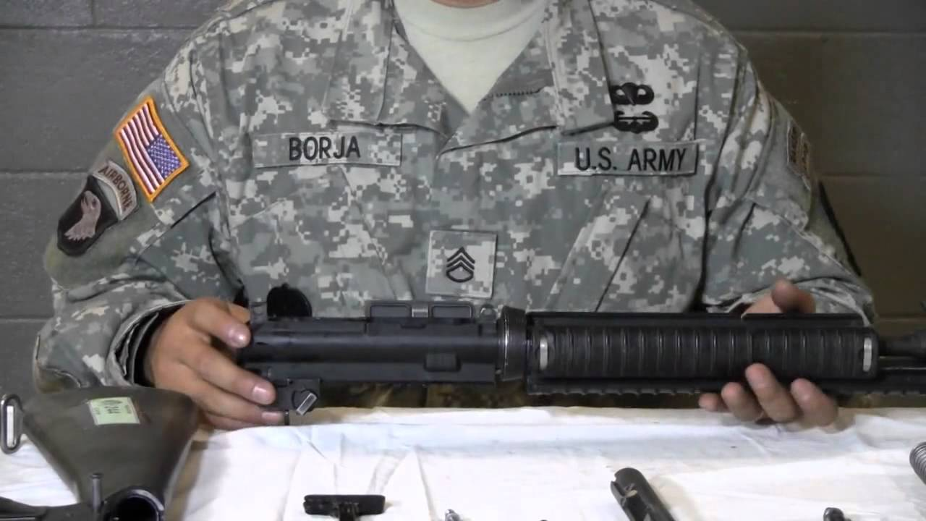

Slide 20
The Sword Of The Spirit
Spend time with our weapon… Don’t only learn what it says, but how to use it properly (2 Tim 2:14-15)
Like a soldier with his weapon… Get to know it intimately and completely
Demands diligence on our part. Work to mastery. Battle ready knowledge!
“Rightly handling the word…” – Accuracy
Sharpening our sword is never a waste of time. Cannot wait until battle to do it!

Slide 21
The Sword Of The Spirit
Practical things to help us take up this sword of the Spirit? (Hebrews 5:11-14)

Slide 22
About this we have much to say, and it is hard to explain, since you have become dull of hearing. For though by this time you ought to be teachers, you need someone to teach you again the basic principles of the oracles of God. You need milk, not solid food, for everyone who lives on milk is unskilled in the word of righteousness, since he is a child. But solid food is for the mature, for those who have their powers of discernment trained by constant practice to distinguish good from evil.

Slide 23
The Sword Of The Spirit
Practical things to help us take up this sword of the Spirit? (Hebrews 5:11-14)
Develop real & concrete study habits
Study with another faithful Christian
Outline, map it (other literary tools)
Follow a daily Bible reading program
Find someone to keep you accountable
Be practical about using the scriptures

Slide 24
NOT YET
Are You Battle Ready?

Slide 25

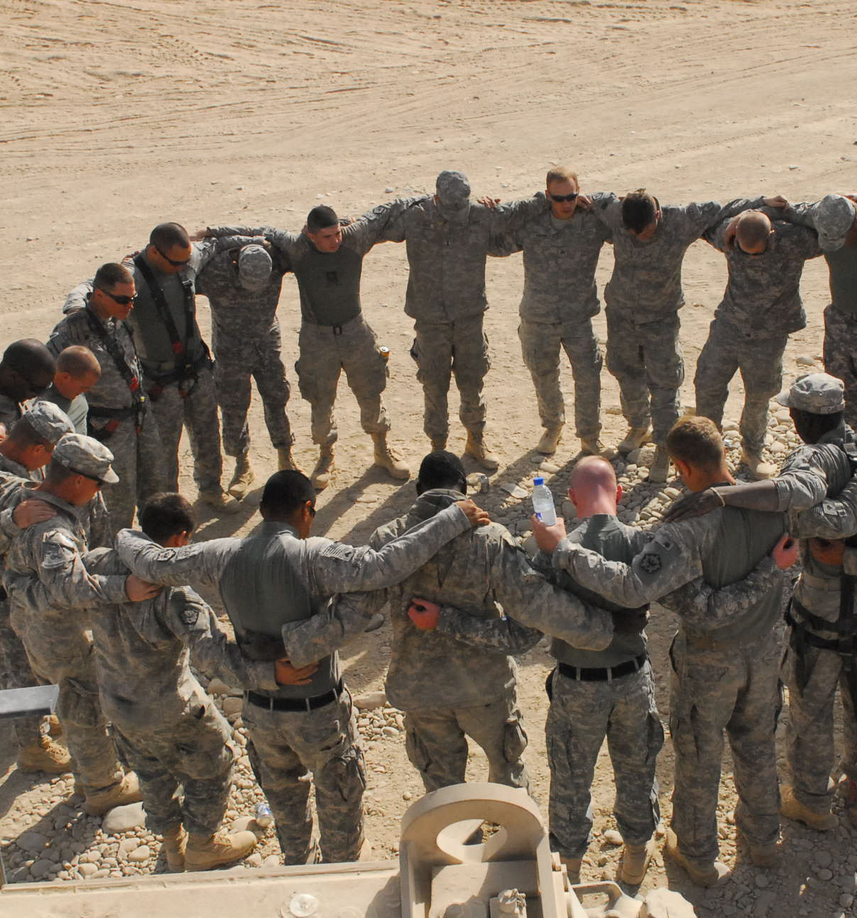
praying at all times in the Spirit, with all prayer and supplication. To that end, keep alert with all perseverance, making supplication for all the saints, and also for me, that words may be given to me in opening my mouth boldly to proclaim the mystery of the gospel, for which I am an ambassador in chains, that I may declare it boldly, as I ought to speak. (vs. 18-20)

Slide 26
Are You Battle Ready?

