Slide 1
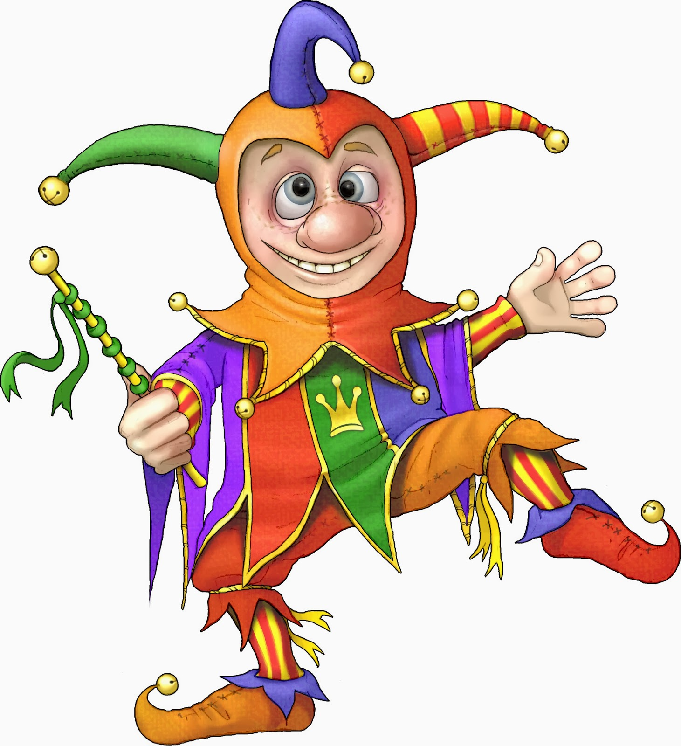

Slide 2
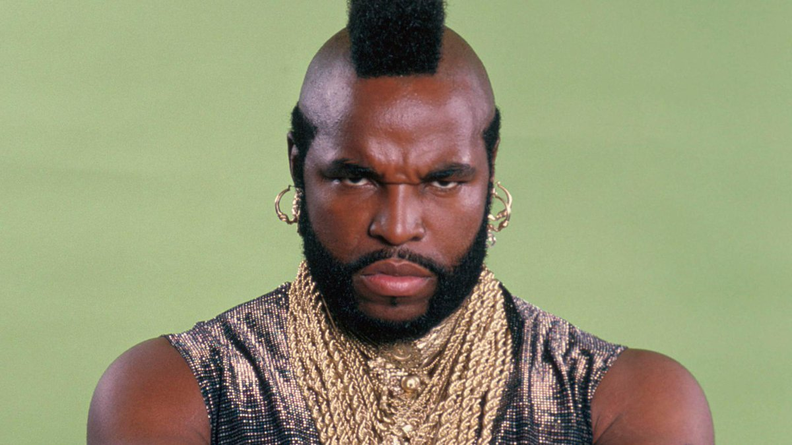
I Pity The Fool

Slide 3
Thinking Like A Fool
A How To Guide

Slide 4

How To Think Foolishly
Believe Everything (Proverbs 14:15)
To know wisdom and instruction, to understand words of insight, to receive instruction in wise dealing, in righteousness, justice, and equity; to give prudence to the simple, knowledge and discretion to the youth (Proverbs 1:2-4)

Slide 5
How To Think Foolishly
Believe Everything (Proverbs 14:15)
“How long, O simple ones, will you love being simple? How long will scoffers delight in their scoffing and fools hate knowledge?” (Proverbs 1:22)

Slide 6
How To Think Foolishly
Believe Everything (Proverbs 14:15)
so that we may no longer be children, tossed to and fro by the waves and carried about by every wind of doctrine, by human cunning, by craftiness in deceitful schemes. (Ephesians 4:14)

Slide 7
How To Think Foolishly
Believe Everything (Proverbs 14:15)
Be Overconfident (Proverbs 14:16)
Therefore let anyone who thinks that he stands take heed lest he fall. No temptation has overtaken you that is not common to man. God is faithful, and he will not let you be tempted beyond your ability, but with the temptation he will also provide the way of escape, that you may be able to endure it. (1 Corinthians 10:12-13)

Slide 8
How To Think Foolishly
Believe Everything (Proverbs 14:15)
Be Overconfident (Proverbs 14:16)
Whoever isolates himself seeks his own desire; he breaks out against all sound judgment. A fool takes no pleasure in understanding, but only in expressing his opinion.
(Proverbs 18:1-2)

Slide 9
How To Think Foolishly
Believe Everything (Proverbs 14:15)
Be Overconfident (Proverbs 14:16)
Do not be deceived: “Bad company ruins good morals.” Wake up from your drunken stupor
(I Corinthians 15:33-34a)

Slide 10
How To Think Foolishly
Believe Everything (Proverbs 14:15)
Be Overconfident (Proverbs 14:16)
Get Emotional (Proverbs 14:17)
Whoever is slow to anger has great understanding, but he who has a hasty temper exalts folly.
(Proverbs 14:29)

Slide 11
How To Think Foolishly
Believe Everything (Proverbs 14:15)
Be Overconfident (Proverbs 14:16)
Get Emotional (Proverbs 14:17)
Now the works of the flesh are evident: sexual immorality, impurity, sensuality, idolatry, sorcery, enmity, strife, jealousy, fits of anger, rivalries, dissensions, divisions, envy, drunkenness, orgies, and things like these. I warn you, as I warned you before, that those who do such things will not inherit the kingdom of God. (Galatians 5:19-21)

Slide 12
How To Think Foolishly
Believe Everything (Proverbs 14:15)
Be Overconfident (Proverbs 14:16)
Get Emotional (Proverbs 14:17)
Make no friendship with a man given to anger, nor go with a wrathful man, lest you learn his ways and entangle yourself in a snare. (Proverbs 22:24-25)

Slide 13
How To Think Foolishly
Believe Everything (Proverbs 14:15)
Be Overconfident (Proverbs 14:16)
Get Emotional (Proverbs 14:17)
Every prudent man acts with knowledge, but a fool flaunts his folly. (Proverbs 13:16)

Slide 14
How To Think Foolishly
Believe Everything (Proverbs 14:15)
Be Overconfident (Proverbs 14:16)
Get Emotional (Proverbs 14:17)
Thinking foolishly may feel good and seem easier in the moment. It may gain the support or even praise of people around us. But know, it ends in ruin, heartache, and regret! (Proverbs 10:8-10)

Slide 15
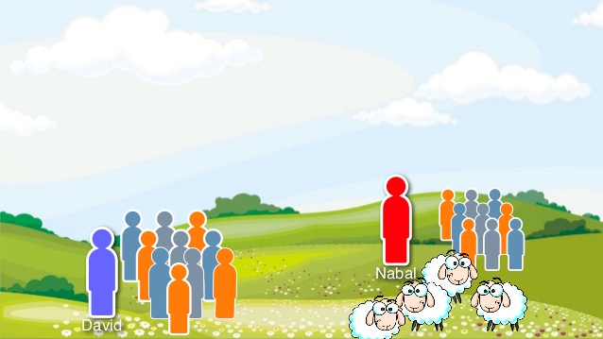
David vs Nabal
Two Men Thinking Foolishly
(I Samuel 25)

Slide 16
Whoever gives thought to the word will discover good, and blessed is he who trusts in the LORD. The wise of heart is called discerning, and sweetness of speech increases persuasiveness. Good sense is a fountain of life to him who has it, but the instruction of fools is folly. The heart of the wise makes his speech judicious and adds persuasiveness to his lips. (Proverbs 16:20-23)
But the fruit of the Spirit is love, joy, peace, patience, kindness, goodness, faithfulness, gentleness, self-control; against such things there is no law. And those who belong to Christ Jesus have crucified the flesh with its passions and desires. (Galatians 5:22-24)

Slide 17
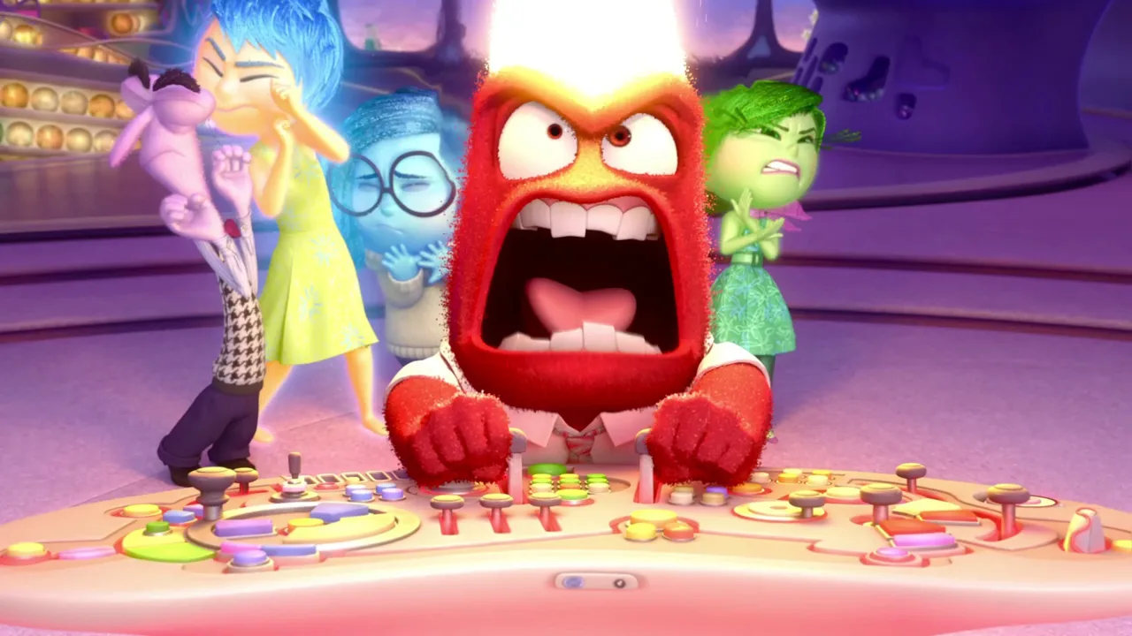
Don’t Do Something Permanently Stupid Because You’re Temporarily Upset

